Slide 1
e-education activities
Funded by the European Union. Views and opinions expressed are however those of the author(s) only and do not necessarily reflect those of the European Union or the European Education and Culture Executive Agency (EACEA). Neither the European Union nor EACEA can be held responsible for them
Project No: 2021-1-IT02-KA220-ADU-000035139

Slide 2
“Preparing people to use digital technology
is one of the most vital responsibilities for the future “

Slide 3
Overview
activity 01:
Introduction to e-education (T)
activity 02:
Exploitation of some e-education platforms/resources (P)
activity 03
Direct engagement with an online course (P)

Slide 4
ACTIVITY 01 Introduction to e-education
2021-1-IT02-KA220-ADU-000035139
1

Slide 5
Activity 01
Introduction to e-education platforms and resources
Target audience:
people not familiar with
e-learning platforms

Slide 6
Activity 01
Introduction to e-education platforms and resources
Activity 01
OUTLINE
0. Context
Get acquainted with the existence of online education
Learn about the existence of different types of online education and courses
Learn how to find different courses and online platforms

Slide 7
2030 Agenda for Sustainable Development
an ambitious plan that sets out to achieve prosperity that is respectful of the planet and its inhabitants.

Slide 8
The threat of climate change is now more real than ever and the SDGs are crucial if we want to avoid compromising our children's future.

Slide 9
This Agenda is made up of
17 Sustainable Development Goals (SDGs)
further broken down into 169 targets,
to be met by 2030
with the intention of "leaving no one behind".

Slide 11
Activity 01
Introduction to e-education platforms and resources
2030
Sustainable development begins with education
Unesco 2015

Slide 12
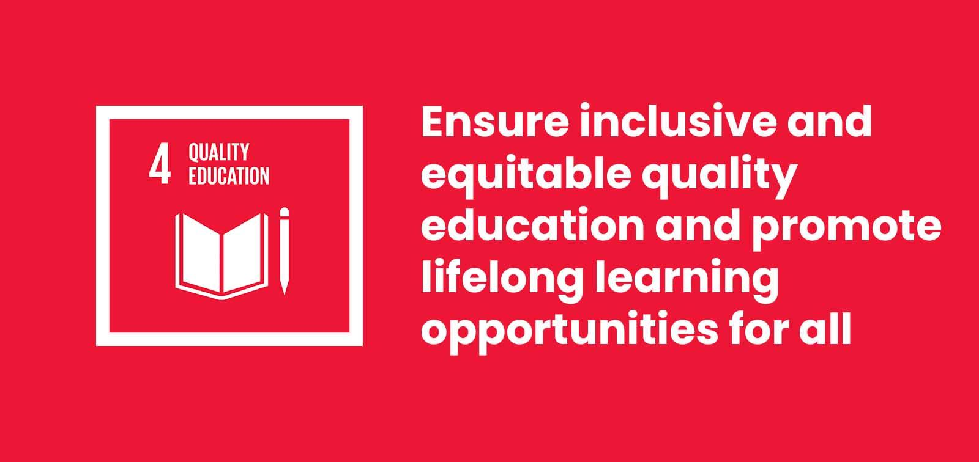
What is E-education?

Slide 13
What is E-education?
what is e-education?
e-learning, electronic learning or education
is a system of education that transfers knowledge and competencies that reaches many people, whether they might or not be in the same space or time
is a system of education that transfers knowledge and competencies that reaches many people, whether they might or not be in the same space or time

Slide 14
Activity 00
Introduction to e-education platforms and resources
Have you ever tried an online course (Y/N)?
What types of courses are possible to follow in online-education?
Is the quality of online education worse than the face-to-face one (Y/N)?
Are all the online courses free of charge (Y/N)?
Can e education be certified?
Fears & concerns?

Slide 15
What is E-education?
2. Why engage in e-education?
trend
eco-friendly
attractive
Why
own time and pace
digital literacy
career progression

Slide 16
What is E-education?
2. Why engage in e-education?
trend
e-learning has transformed education
attractive
learners more focused and less distracted
digital literacy
no one should be left behind
career progression
can help increase the efficiency of the employees
own time and pace
learners can adapt learning curve
eco-friendly
helps massively to reduce CO2 emissions and energy consumption

Slide 17
What is E-education?
3. How engage in e-education?
Multiple Formats
Self-assessment
Active Learning Opportunities
How
Gamification
Feedback
Interaction

Slide 18
What is E-education?
3. How engage in e-education?
Multiple Formats
different platforms and formats will be beneficial and engage the learners' attention
Active Learning Opportunities
will never let learners bored and help to involve
Feedback
collecting ideas for potential improvements may also be relevant
Interaction
Learners will experience inclusiveness through discussion and engagement
Gamification
experience a community atmosphere and unconsciously learn new content
Self-assessment
opportunities increase responsibility on engagement

Slide 19
What is E-education?
4. e-education Benefits
Easy access
Homy
Self-directed learning
Theme variety
Unlimited learning tools
Collaborative learning
Reduced resources
Cheaper
Red-Do
Growth
Interactive
Easy access
Self-directed learning
Theme variety
Unlimited learning tools
Collaborative learning
Reduced resources
Cheaper
Red-Do
Growth
Interactive

Slide 20
What is E-education?
4. e-education Benefits
Easy access
lessons regardless of location, avoiding travelling and being away from home for long periods
Homy
learning in one's home gives flexibility that other traditional ways of teaching can’t offer
Self-directed learning
learn how to schedule and plan their daily activities
Theme variety
larger offer and variety of online training courses, methods and teachers
Unlimited learning tools
almost unlimited contents and study areas

Slide 21
What is E-education?
4. e-education Benefits
Collaborative learning.
collaborative spaces where they can share and learn new information and help each other
Reduced resources
only a computer, a phone and the internet are needed,
Cheaper
cheaper formative offers in comparison to face-to-face options.
Red-Do
possibility of restoring, repeating, or replacing classes.
Growth
more people access to higher levels of education, resulting levels of social wealth
Interactive
active learning-teaching processes and also creativity and innovation.

Slide 22
What is E-education?
5. e-education Challenges
infrastructure
focus
team building
mental health

Slide 23
What is E-education?
5. e-education Challenges
communication infrastructure
poor internet infrastructures, low coverage and connection failures
focus
adult learner can focus for about 20 min. modules to be somewhere between 10 /15min
team building
e-learning prevents face-to-face encounters, which can hinder the belonging feeling to a group or class
mental health
Lack of personal and social interaction cand lead to isolation or mental health issues

Slide 24
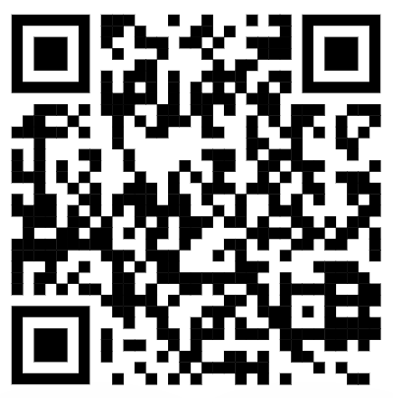
What is E-education?
5. e-education Challenges
e education versus offline education
On-Site benefits | On-Line benefits
On-Site Challenges | On-Line Challenges
https://pinup.com/FSJXlslZy

Slide 25
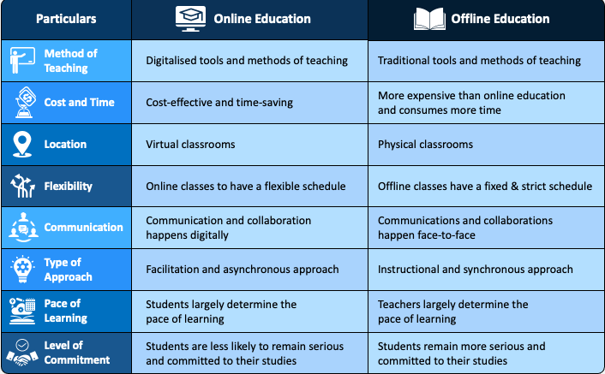
What is E-education?
5. e-education Challenges
e education versus offline education

Slide 26
What is E-education?
6. Is there e-education certification?
There are three general types of certification.
Certificates
Diplomas
Degrees

Slide 27
What is E-education?
6. Is there e-education certification?
Degrees
Check Your National Education Ministry or other Governmental Organism!
Best Certified Online Courses sites available in Portugal
https://forum.pt/escolas/quais-os-melhores-sites-de-cursos-online-certificados
Codecademy (programming)
Busuu (languages)
Domestika (photography)
Udacity (information systems)
IMF Business School Portugal School (management)
https://www.dgert.gov.pt/

Slide 28
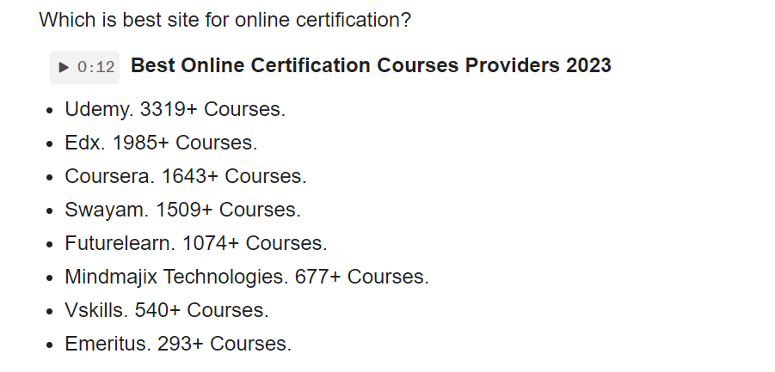
What is E-education?
6. Is there e-education certification?
If your interested in a DEGREE…
Check Your National Education Ministry or other Governmental Organism for online certification companies!

Slide 29
Project No: 2021-1-DE02-KA220-VET-000030542
Thank you!
Follow us on Facebook!
https://www.facebook.com/digequalproject
Funded by the European Union. Views and opinions expressed are however those of the author(s) only and do not necessarily reflect those of the European Union or the European Education and Culture Executive Agency (EACEA). Neither the European Union nor EACEA can be held responsible for them
Project No: 2021-1-IT02-KA220-ADU-000035139

Slide 30
e-education activities
Activity 2
Funded by the European Union. Views and opinions expressed are however those of the author(s) only and do not necessarily reflect those of the European Union or the European Education and Culture Executive Agency (EACEA). Neither the European Union nor EACEA can be held responsible for them
Developed by Universidade de Aveiro | January, 2023
Project No: 2021-1-IT02-KA220-ADU-000035139

Slide 31
“Preparing people to use digital technology
is one of the most vital responsibilities for the future “

Slide 32
Overview
Ice breaker
activity 01: Introduction to e-education platforms and resources
activity 02: Exploitation of some e-education platforms/resources
activity 03: Direct engagement with an online course

Slide 33
ACTIVITY 02 Exploitation of some e-education platforms/resources
2021-1-IT02-KA220-ADU-000035139
1

Slide 34
Activity 02
Exploitation of some e-education platforms/resources
Activity
OUTLINE
Introductory presentation, where some platforms are shown to the audience
Learn how to navigate through online teaching platforms: exploring e-learning web sites

Slide 35
Activity 02
Exploitation of some e-education platforms/resources

Slide 36
Activity 02.part1
Exploitation of some e-education platforms/resources
Platform examples
E-LEARNING
27 Best Online Learning Platforms (updated 2023)
www.coursera.org
www.open.ac.uk
www.youtube.com
https://learndigital.withgoogle.com/digitalgarage/
One of the suggested platforms is Coursera, but the audience would be fully able to use any preferred platform during the activity.
learnworlds.com

Slide 37
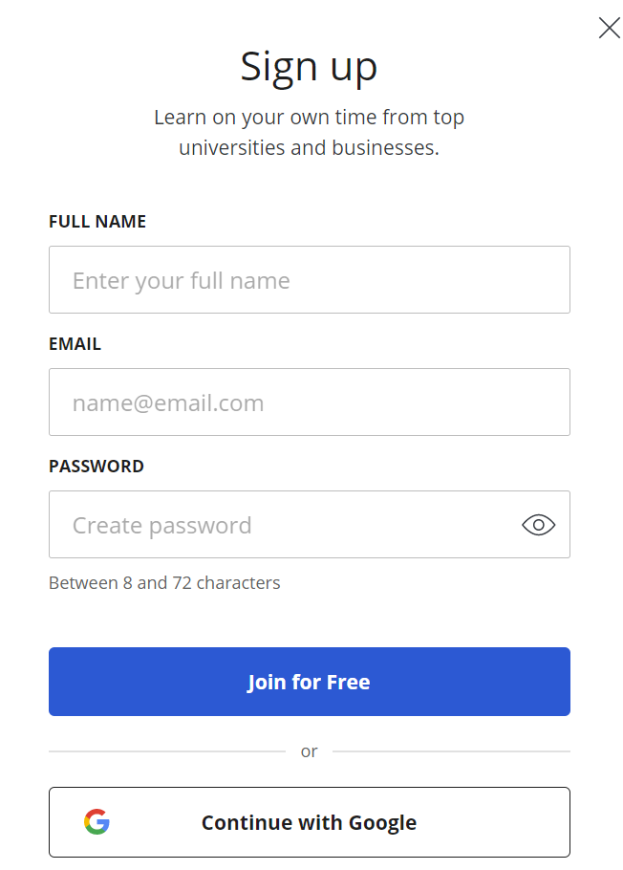
Activity 02.part1
Exploitation of some e-education platforms/resources
Explore!
Go to www.coursera.org
Create free account
www.coursera.org

Slide 38
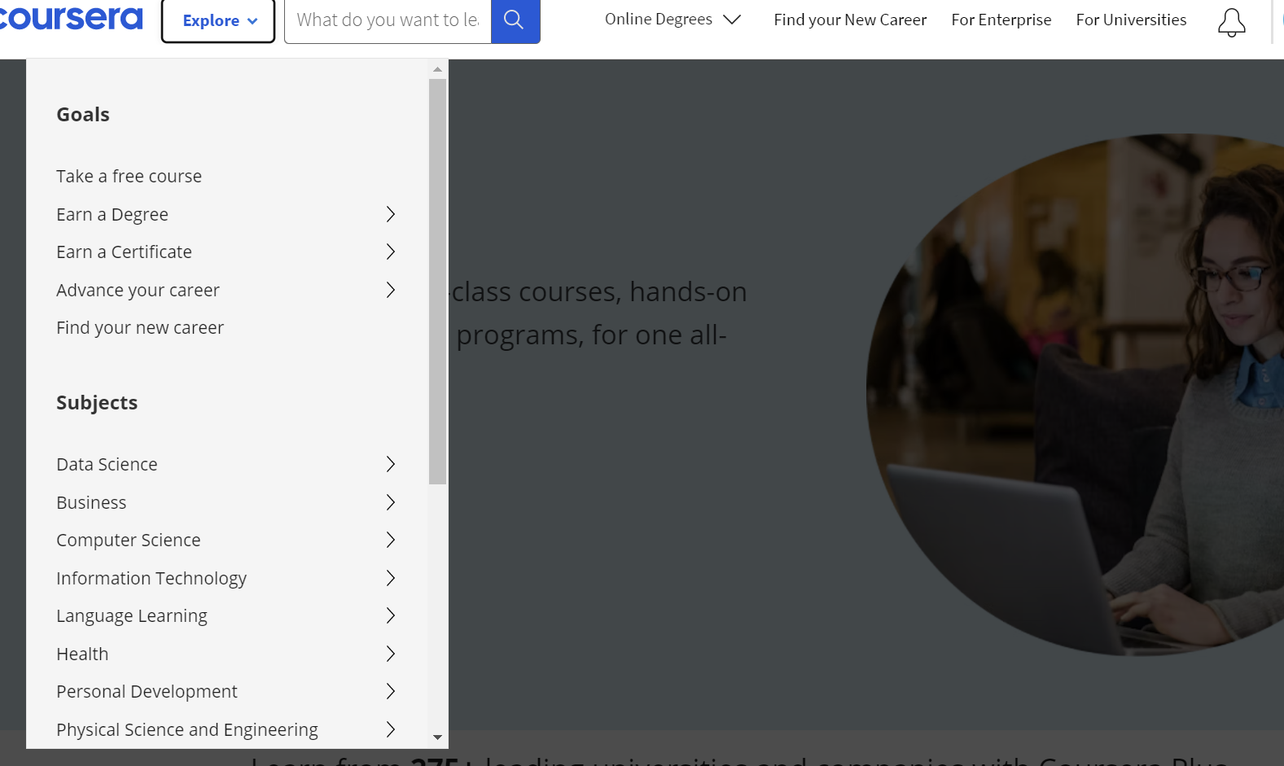
Activity 02.part1
Exploitation of some e-education platforms/resources
3. Take a free course
Explore!
www.coursera.org

Slide 39
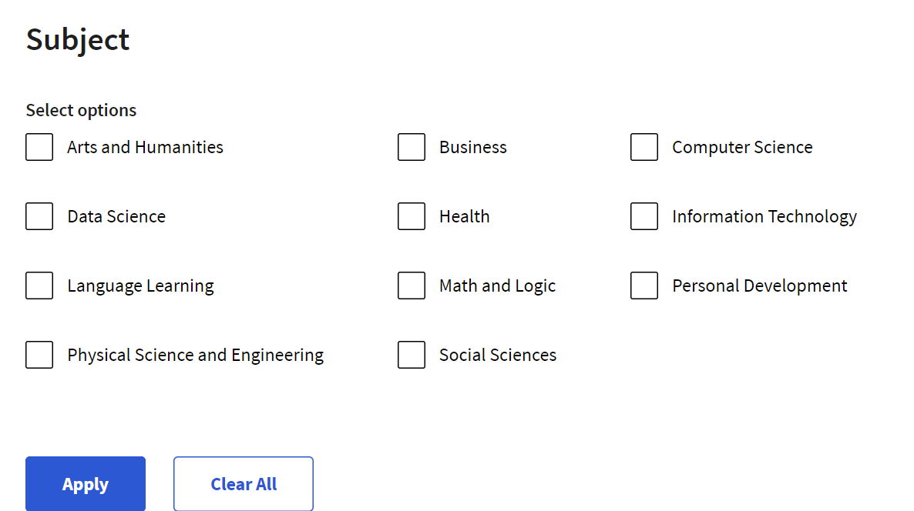
Activity 02.part1
Exploitation of some e-education platforms/resources
4. Choose a subject
Explore!
X
X
www.coursera.org

Slide 40
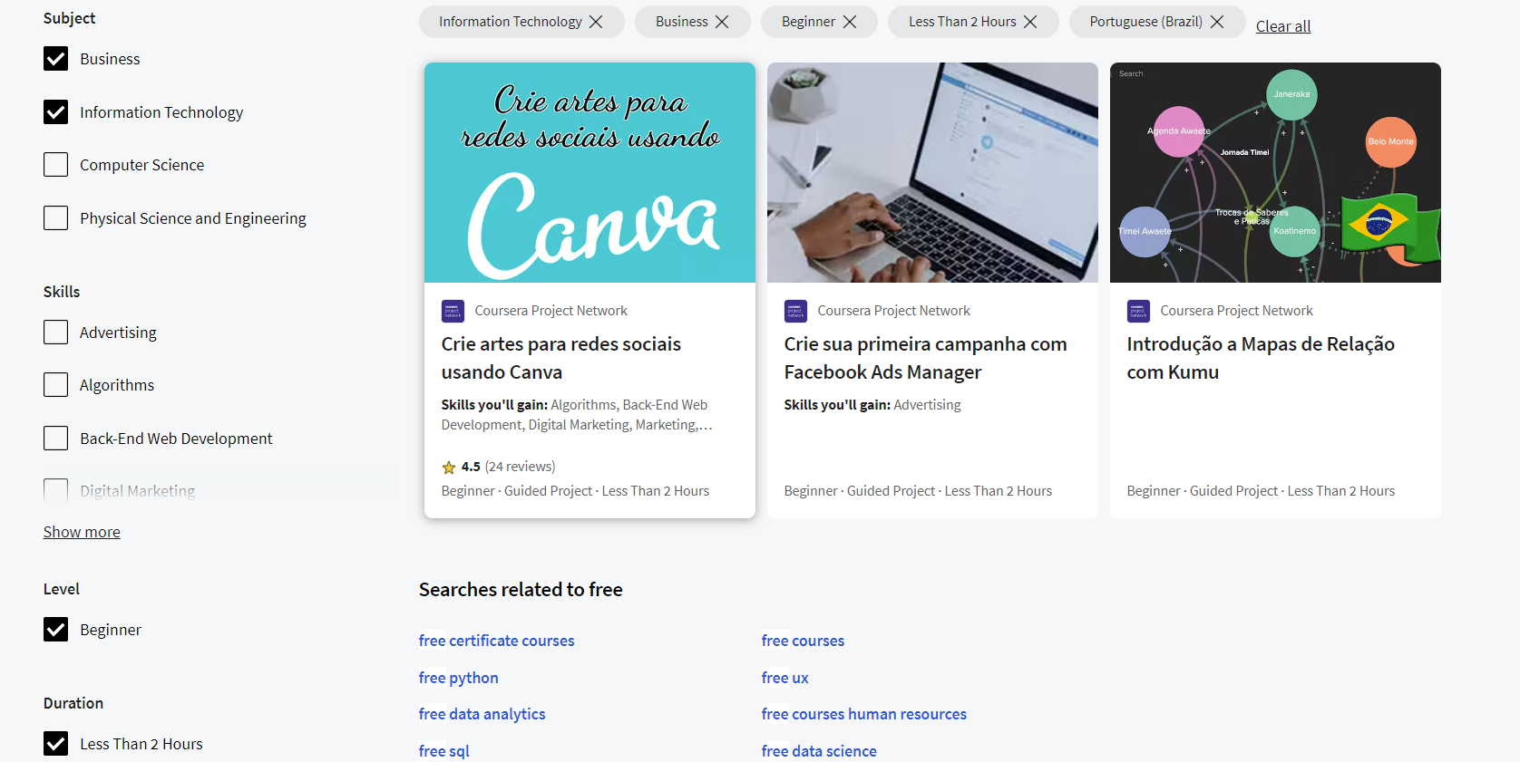
Activity 02.part1
Exploitation of some e-education platforms/resources
5. Pick a course
Explore!
www.coursera.org

Slide 41
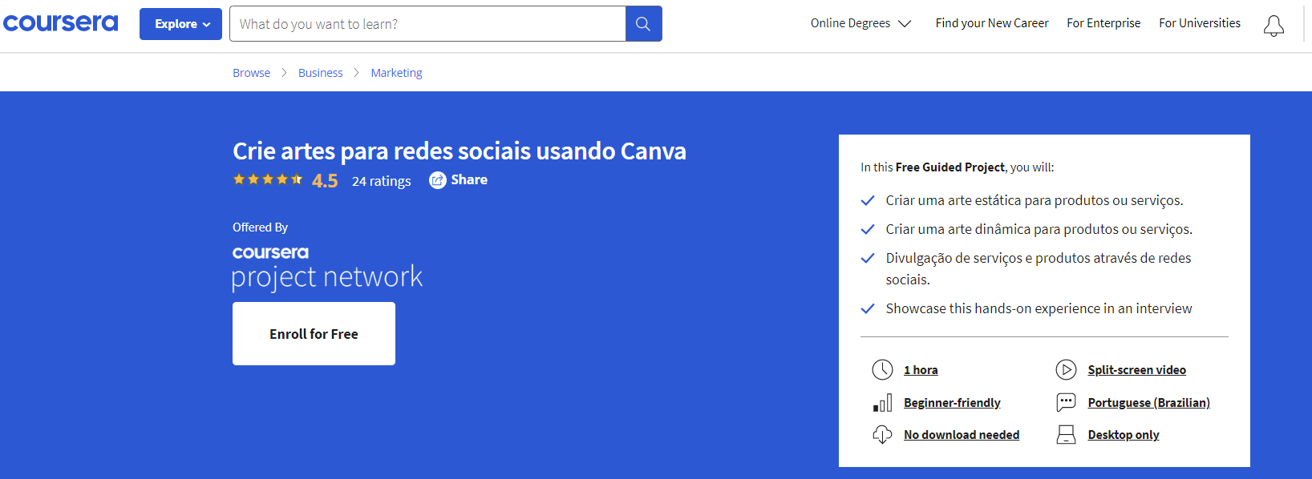
Activity 02.part1
Exploitation of some e-education platforms/resources
6. You are ready to enroll for free and start learning!
Explore!
www.coursera.org

Slide 42
Activity 02.part2
Exploitation of some e-education platforms/resources
Discussion, in which every participant would be able to talk about their experience.
The discussion would talk about what were the biggest difficulties the audience found when searching for an online course or what they thought were the most positive points of the platforms.
Use online whiteboards to share ideas!

Slide 43
Activity 02.part3
Exploitation of some e-education platforms/resources
Name 3 online courses they would like to engage with in the future.
Use online whiteboards to share ideas!

Slide 44
Project No: 2021-1-DE02-KA220-VET-000030542
Thank you!
Follow us on Facebook!
https://www.facebook.com/digequalproject
Funded by the European Union. Views and opinions expressed are however those of the author(s) only and do not necessarily reflect those of the European Union or the European Education and Culture Executive Agency (EACEA). Neither the European Union nor EACEA can be held responsible for them
Project No: 2021-1-IT02-KA220-ADU-000035139

Slide 45
e-education activities
Activity 3
Funded by the European Union. Views and opinions expressed are however those of the author(s) only and do not necessarily reflect those of the European Union or the European Education and Culture Executive Agency (EACEA). Neither the European Union nor EACEA can be held responsible for them
Developed by Universidade de Aveiro | January, 2023
Project No: 2021-1-IT02-KA220-ADU-000035139

Slide 46
ACTIVITY 03 Direct engagement with an online course
2021-1-IT02-KA220-ADU-000035139
1

Slide 47
Activity 03
Direct engagement with an online course
Activity
OUTLINE
Learn how to use and exploit all the learning materials made available by online courses
Acquisition of skills conferred by the information provided

Slide 48
Activity 03.part1
Direct engagement with an online course
Choose an online platform where online courses are available. You should search for 3 courses:
a course that teaches you how to play a musical instrument
a course that teaches you a new language
a course that teaches you how to care for aromatic plants

Slide 49
Activity 03
Direct engagement with an online course
Make a list of the benefits and advantages of each of the courses you have previously found

Slide 50
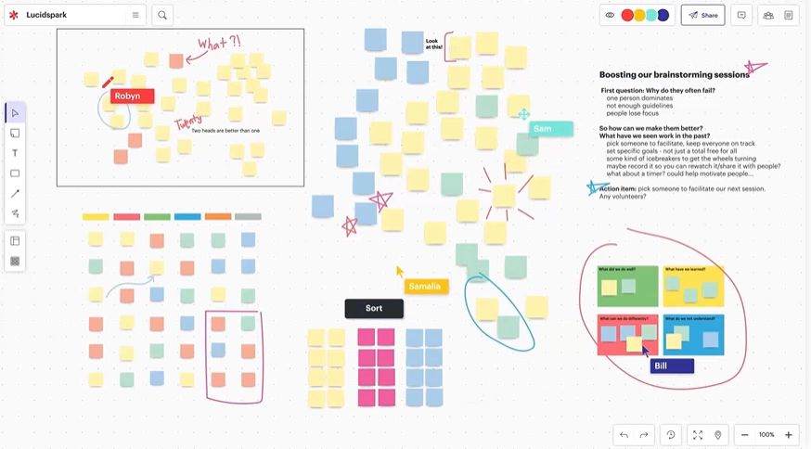
Activity 03.part2
Direct engagement with an online course
Use online whiteboards to share ideas!
https://lucidspark.com/

Slide 51
Project No: 2021-1-DE02-KA220-VET-000030542
Thank you!
Follow us on Facebook!
https://www.facebook.com/digequalproject
Funded by the European Union. Views and opinions expressed are however those of the author(s) only and do not necessarily reflect those of the European Union or the European Education and Culture Executive Agency (EACEA). Neither the European Union nor EACEA can be held responsible for them
Project No: 2021-1-IT02-KA220-ADU-000035139

