Slide 1
E-health
How technology changes the way we manage our health
Lesson 1.
The importance of literacy in e-health
Funded by the European Union. Views and opinions expressed are however those of the author(s) only and do not necessarily reflect those of the European Union or the European Education and Culture Executive Agency (EACEA). Neither the European Union nor EACEA can be held responsible for them.
Project No: 2021-1-IT02-KA220-ADU-000035139

Slide 2
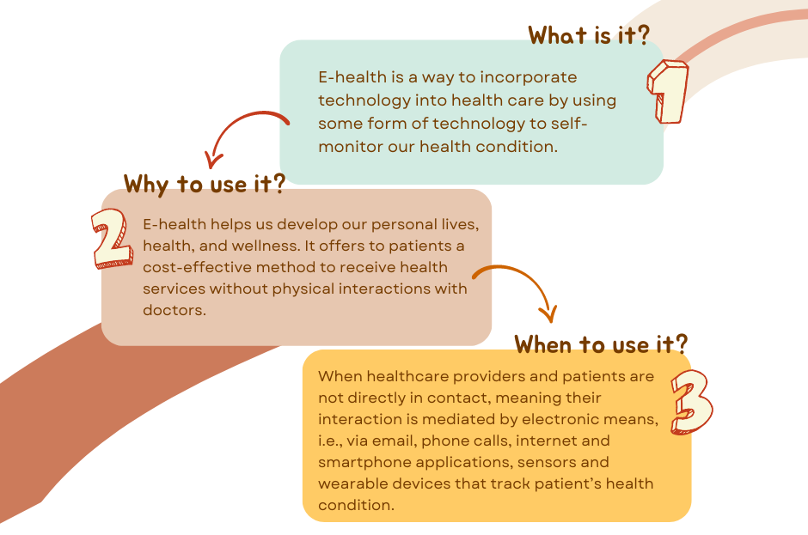
Let’s make an introduction to e-health:
2021-1-IT02-KA220-ADU-000035139
2

Slide 3
Without literacy there is no e-health
2021-1-IT02-KA220-ADU-000035139
E-health literacy is the ability to search, find, understand and evaluate health information from electronic sources, i.e., Internet, and apply the gain knowledge in order to address of solve health problems.
Example:
I feel sick and I am not sure what my symptoms mean. I surf on the internet and find many sites that refer to my symptoms but all of them have different findings. I must contact my doctor but I cannot be physically present because of work. So, I contact my doctor via phone, to guide me that the sources I've discovered are trustworthy and the information is reliable.
3

Slide 4
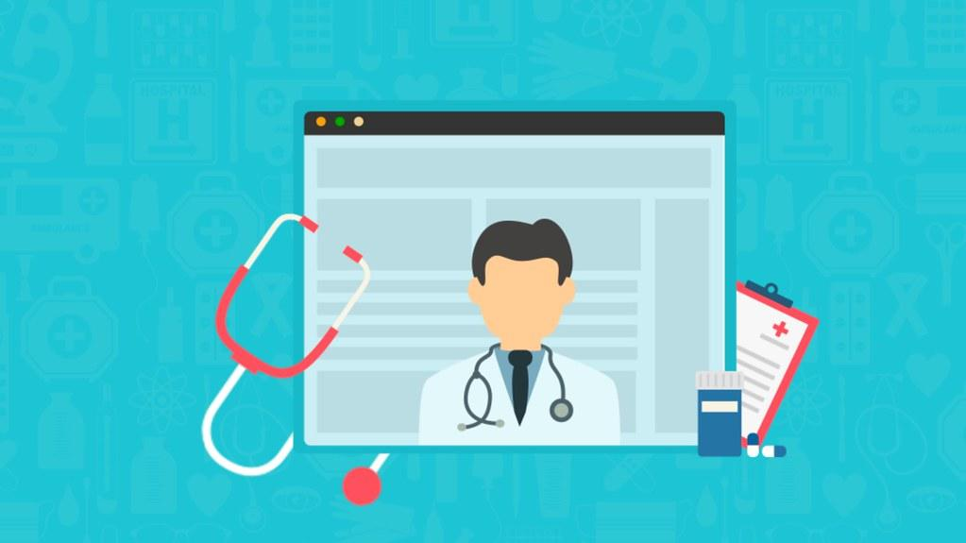
E-health literacy can be useful when:
2021-1-IT02-KA220-ADU-000035139
Scheduling an online appointment
Allows patients to book or reschedule appointments with their healthcare providers.
Receiving telemedicine consultations
Allow patients to receive medical consultations through video or voice calls, avoiding the need for an in-person visit.
4

Slide 5
E-health literacy can be useful when:
2021-1-IT02-KA220-ADU-000035139
Managing personal health records
Allow patients to access and manage their personal health information, including test results, medications, and medical history.
Have access to health information resources
Provide access to articles, videos, and educational materials on various health topics, as well as access to online communities and forums for support and advice.
5

Slide 6
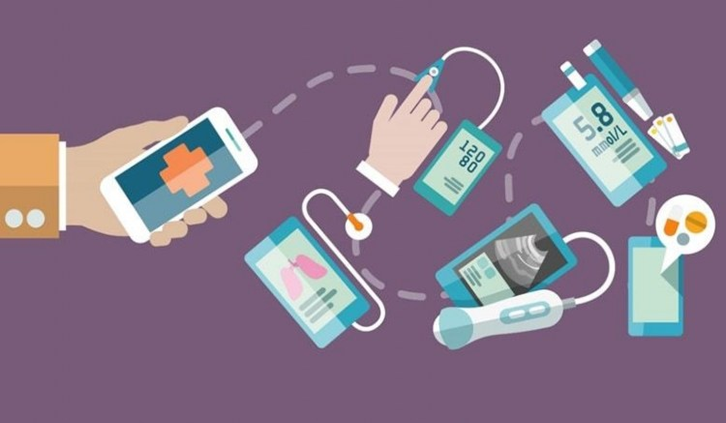
E-health literacy can be useful when:
2021-1-IT02-KA220-ADU-000035139
Remote monitoring while using sensors and wearables
Using wearable devices or digital sensors to monitor patients' health status and share the data with healthcare providers.
Managing medication
Providing reminders and alerts for taking
medications, ordering refills, and tracking medication history.
Tracking progress through fitness and wellness apps
Offers personalized exercise and nutrition programs, tracking progress and providing support to maintain healthy habits.
6

Slide 7
Assess your own knowledge on e-health literacy
2021-1-IT02-KA220-ADU-000035139
Let’s see if you can assess your own knowledge
on e-health literacy and online services!
Move on to the next slide…..
7

Slide 8
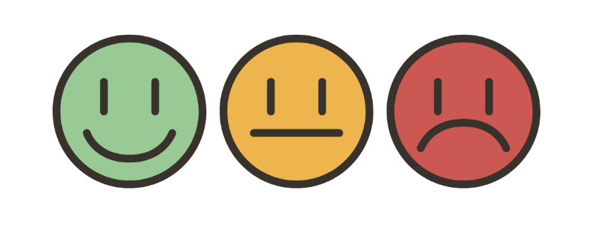
In class Activity 1: E-health literacy
2021-1-IT02-KA220-ADU-000035139
How do you think e-health literacy could affect you personally?
How good are you at using online services to manage your health?
Do you think e-health services are useful? To what extent?
Take the e-health literacy
test to find out.
8

Slide 9
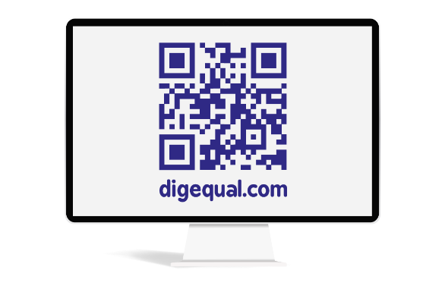
Project No: 2021-1-DE02-KA220-VET-000030542
Thank you!
Follow us on Facebook!
Project No: 2021-1-IT02-KA220-ADU-000035139

Slide 10
E-health
How technology changes the way we manage our health
Lesson 2.
Understanding our nutrition, fitness and health management knowledge
Funded by the European Union. Views and opinions expressed are however those of the author(s) only and do not necessarily reflect those of the European Union or the European Education and Culture Executive Agency (EACEA). Neither the European Union nor EACEA can be held responsible for them.
Developed by Eurosuccess Consulting | Dec, 2022
Project No: 2021-1-IT02-KA220-ADU-000035139

Slide 11
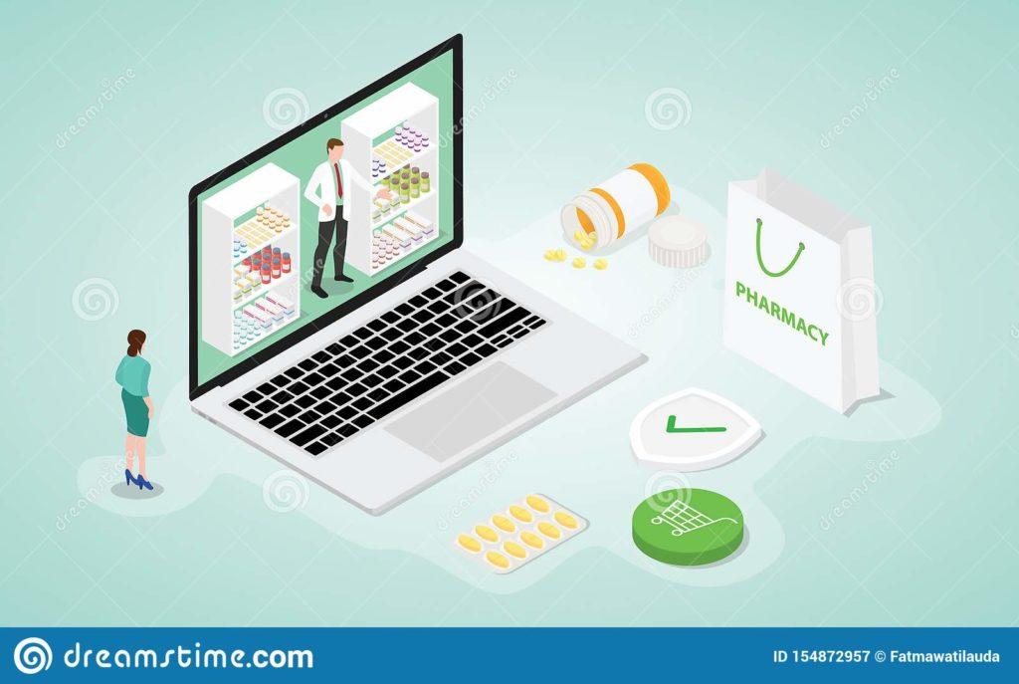
When using online services….
2021-1-IT02-KA220-ADU-000035139
Access a vast array of resources and information right at our fingertips, i.e., researching symptoms, finding reputable medical articles, or connecting with healthcare professionals through telemedicine,
Empower ourselves with knowledge and make informed decisions about our health.
11

Slide 12
Nutrition Management when using online services
2021-1-IT02-KA220-ADU-000035139
Online platforms and applications:
Enable users to access a wealth of nutritional information, including ingredient lists, portion sizes, and nutrient breakdowns, facilitating informed food choices.
Offer incredible range of resources and tools to support individuals’ dietary and nutritional goals, from personalized meal plans, recipe databases, calorie trackers, even to virtual nutrition coaching.
Offer valuable insights, track our progress, and provide healthier choices to achieve a healthier lifestyle.
12

Slide 13
Fitness Management when using online services
2021-1-IT02-KA220-ADU-000035139
Online platforms and applications:
Provide access to a wide range of workout routines, exercise tutorials, and fitness plans tailored to specific needs and preferences, including features like progress tracking, virtual coaching, and community support, which can help individuals stay motivated and accountable.
Offer interactive features such as live streaming classes or virtual personal training sessions, allowing users to exercise from the comfort of their own homes.
Manage our fitness routines, track our progress, and make significant strides towards a healthier lifestyle.
13

Slide 14
Health Knowledge Management when using online services
2021-1-IT02-KA220-ADU-000035139
Online platforms and applications:
Enable us to educate ourselves about specific conditions, treatments, and preventive measures.
Provide tools for tracking personal health data, such as fitness levels, sleep patterns, and vital signs, which can help us monitor their overall well-being.
Access wealth of information at our disposal through resources, including medical articles, research studies, symptom checkers, and health forums, allowing us to access information on various health topics.
Empower ourselves with valuable insights, to be able to make informed decisions about our health, and actively participate in our own well-being.
14

Slide 15
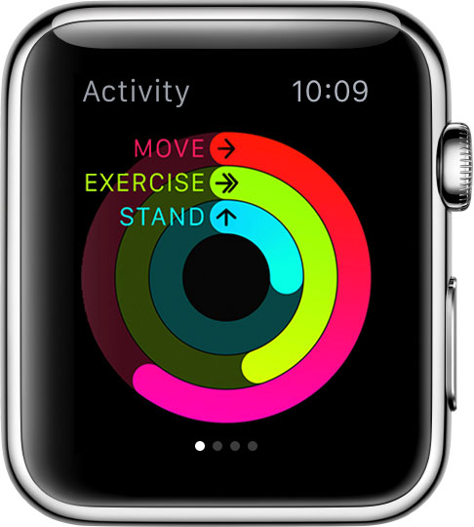
Most known healthcare applications
2021-1-IT02-KA220-ADU-000035139
Gives a comprehensive view of someone’s fitness, activity details, workouts, daily steps and diet tracking, sleep schedule, reminders to log schedules medications, health records storage as allergies, lab results, chronic conditions like diabetes, heart failure etc., shares location with emergency contacts in case of emergency, i.e., heart attack.
Apple Fitness+
Apple Health
My Fitness Pal
Rimidi App
Medical ID App
15

Slide 16
Most known Healthcare Games
2021-1-IT02-KA220-ADU-000035139
Special video-games are considered to be learning resources for people wishing to learn more about diseases, healthcare tips, medication, sleep, mental health, energy, body composition, digestion, and fitness.
Mango Health App
Hartgame
Health IQ Test
16

Slide 17
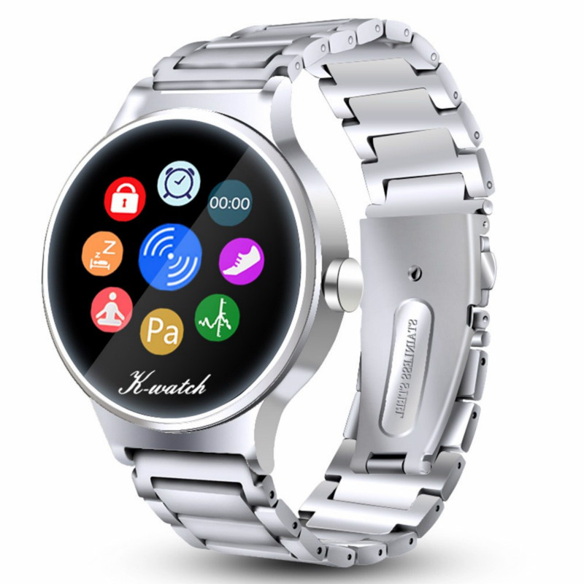
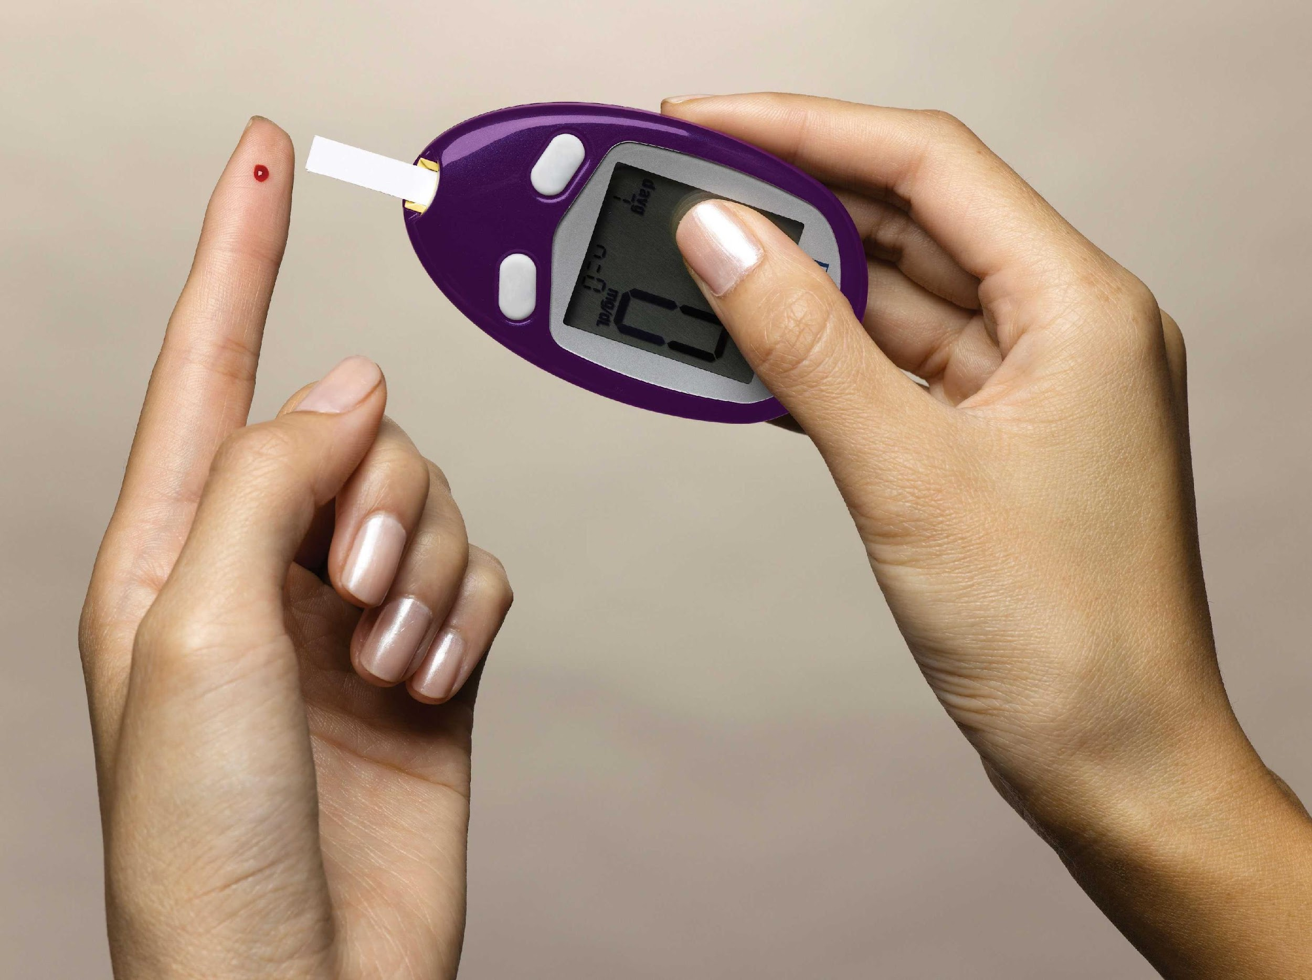
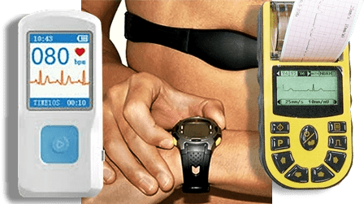
Most known wearable technology
2021-1-IT02-KA220-ADU-000035139
Wearable devices such as smart clothing, wristbands, glasses, watches, shoes, socks, hats, bracelets, etc., monitor and collect information on our health and physical condition, i.e., track vital signs as heart rate, blood pressure, steps, calories, sleep quality, fall detection, medication adherence, blood sugar levels, etc.
Health Watches
Blood Pressure Monitors
Glucose Meters
ECG Monitors
17

Slide 18
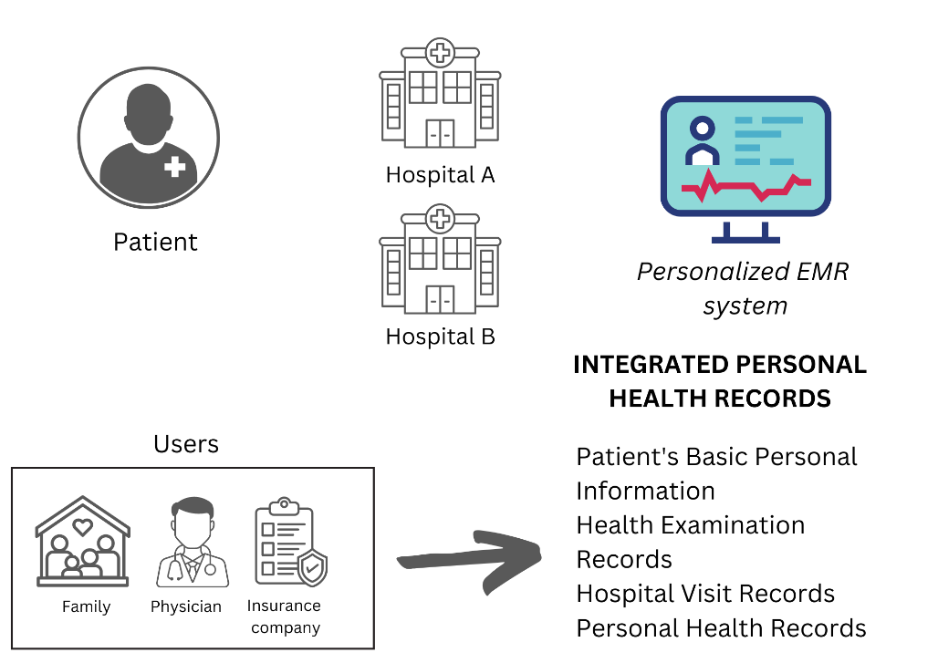
Most known types of e-health and their meaning
2021-1-IT02-KA220-ADU-000035139
Electronic Health Record (EHR):
Collects electronic health information about a patient, which includes their medical history, medications and allergies, immunisation status, laboratory test results, radiographs, vital signs, personal statistics such as age and weight, progress notes and problem details.
18

Slide 19
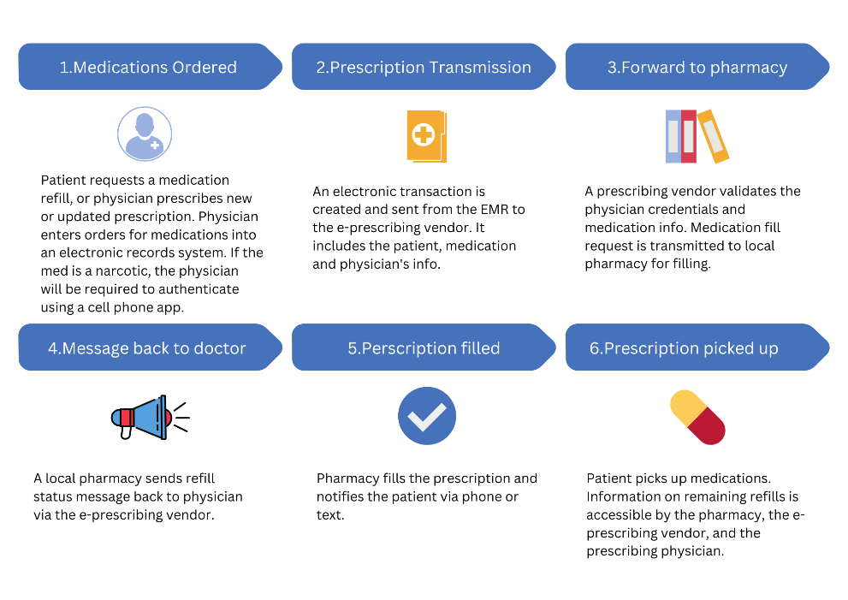
Most known types of e-health and their meaning
2021-1-IT02-KA220-ADU-000035139
2. E-Prescribing:
Access to prescribing options, printing prescriptions to patients and sometimes electronic transmission of prescriptions from doctors to pharmacists.
19

Slide 20
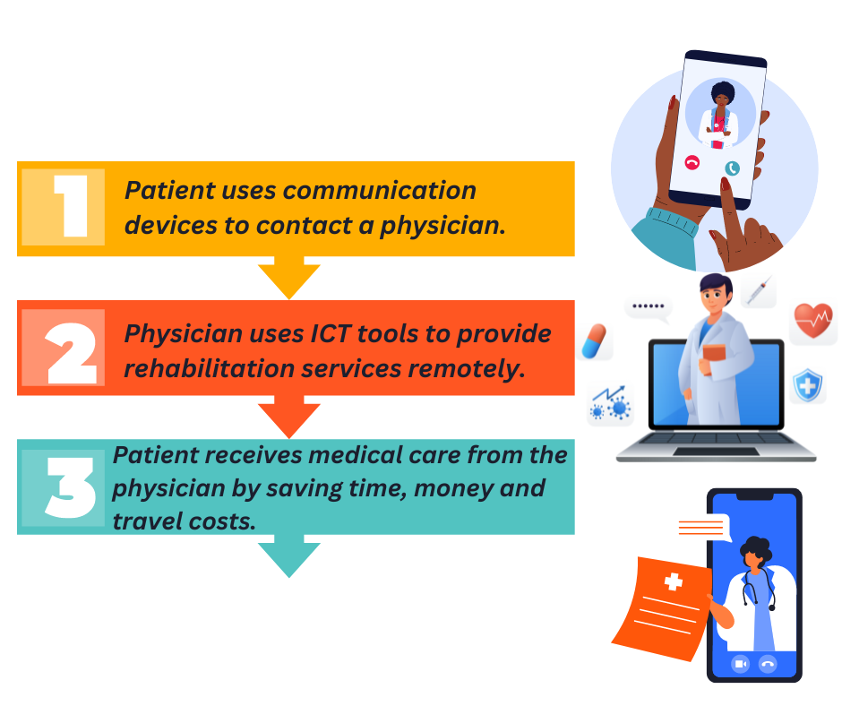
Most known types of e-health and their meaning
2021-1-IT02-KA220-ADU-000035139
3. Telehealth, telemedicine & telerehabilitation:
Telemedicine is the remote physical and psychological diagnosis and treatment, including telemonitoring of patient data and video conferencing.
Telerehabilitation is the use of information and communication technologies (ICT) to provide rehabilitation services to people remotely in their home or other environments, also known as, telecommunication (communication over a distance).
Telehealth: people in remote areas with limited access to healthcare can get the medical care they need by saving time, money and travel costs for doctors and patients.
20

Slide 21
Most known types of e-health and their meaning
2021-1-IT02-KA220-ADU-000035139
4. Consumer Health Informatics (CHI):
Patients use electronic resources, i.e., Internet, as a research tool for condition and treatment information on medical topics in order to manage their health concerns. Thus, patients interact directly with the healthcare system online, without the presence of a healthcare professional.
Patients can use devices, such as computers, mobile phones/tablets or any monitoring devices at home, by different methods, i.e., voice, SMS, Internet, emails, which are organized in an application way, in order to interact with health care providers (physicians, hospitals).
21

Slide 22
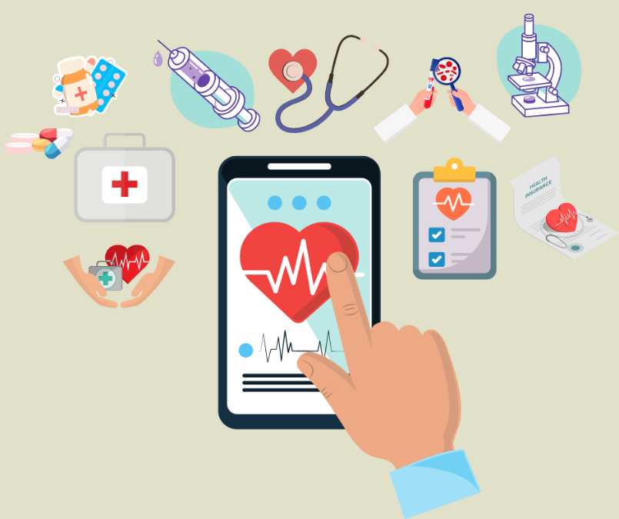
Most known types of e-health and their meaning
2021-1-IT02-KA220-ADU-000035139
5. M-health:
The use of mobile devices, smartphones and portable electronic devices for health purposes.
22

Slide 23
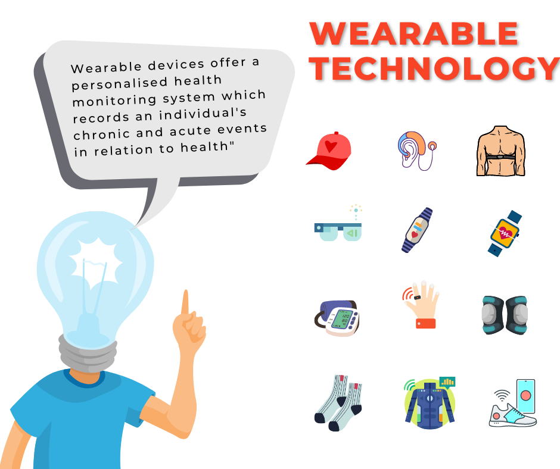
Most known types of e-health and their meaning
2021-1-IT02-KA220-ADU-000035139
6. Sensors and Wearable Devices:
Such devices allow continuous health monitoring and prevention at low cost. Sensors can be integrated into various accessories such as clothing, hats, wristbands, socks, shoes, glasses and other devices such as wristwatches, headphones and smartphones.
In case of e-health devices, wearable technologies collect a very large amount of personal data, stored in cloud platforms, monitored by medical practitioners and trigger notifications in case of unusual data, i.e., heart attack, etc.
23

Slide 24
In class Activity 2: Test your nutrition, fitness and health knowledge
2021-1-IT02-KA220-ADU-000035139
Do you think managing our health online is important? Why?
How useful do you find health online services?
Test your knowledge to find out.
24

Slide 25
Project No: 2021-1-DE02-KA220-VET-000030542
Thank you!
Follow us on Facebook!
Project No: 2021-1-IT02-KA220-ADU-000035139

Slide 26
E-health
How technology changes the way we manage our health
Lesson 3.
The importance of online services
in e-health
Funded by the European Union. Views and opinions expressed are however those of the author(s) only and do not necessarily reflect those of the European Union or the European Education and Culture Executive Agency (EACEA). Neither the European Union nor EACEA can be held responsible for them.
Developed by Eurosuccess Consulting | Dec, 2022
Project No: 2021-1-IT02-KA220-ADU-000035139

Slide 27
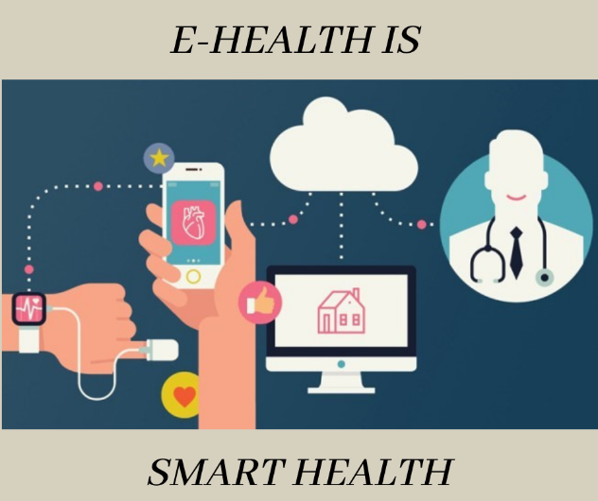
E-HEALTH IS SMART HEALTH: Current Technologies and Services
2021-1-IT02-KA220-ADU-000035139
Five reasons that e-health is a smart health for patients:
Improves access to medical records
Reduces costs
Increases quality
Provides personalized medicine
Enables managing and tracking health and wellness activities efficiently.
27

Slide 28
Benefits of using e-health services
2021-1-IT02-KA220-ADU-000035139
Improved patient monitoring
Communication is easier with this new digital channel, helping to bridge the gap between doctors and patients. Technology also means the patient's condition can be monitored, and their progress can be recorded in real-time
28

Slide 29
Benefits of using e-health services
2021-1-IT02-KA220-ADU-000035139
2. More informed patients
As patients, we can make better health decisions when we understand them and have the power to manage our own health. ICTs also provide access to guidebooks and best practices, which are very useful, for instance, during the pandemic if they come from reliable sources
29

Slide 30
Benefits of using e-health services
2021-1-IT02-KA220-ADU-000035139
3. Encouraging healthier habits
New technologies are changing the way we look after ourselves with apps and devices that track what we eat, how much exercise we do, how long or soundly we sleep and how fast our heart rate is.
30

Slide 31
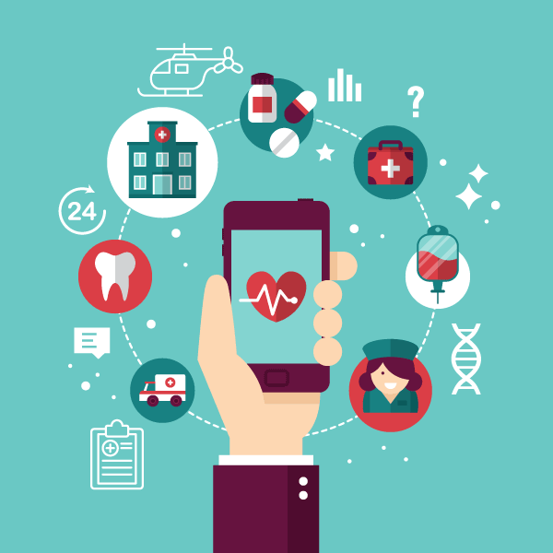
Benefits of using e-health services
2021-1-IT02-KA220-ADU-000035139
4. Easier decision-making for healthcare staff
E-Health also transforms how professionals deal with diseases. ICTs can help, for instance, to identify optimal treatments more easily or detect illnesses at an early stage.
31

Slide 32
Benefits of using e-health services
2021-1-IT02-KA220-ADU-000035139
5. More accessible and equal healthcare
Access to healthcare is no longer limited by time and space, which means avoiding unnecessary travel. Moreover, technology brings healthcare to more people, especially patients at risk of exclusion, which means equal opportunities for everyone.
32

Slide 33
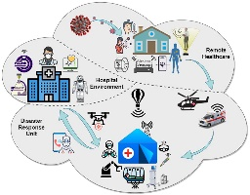
Benefits of using e-health services
2021-1-IT02-KA220-ADU-000035139
6. More efficient hospitals and health clinics
Connected facilities mean a streamlined health system, minimising the chance of human error and cutting costs.
33

Slide 34
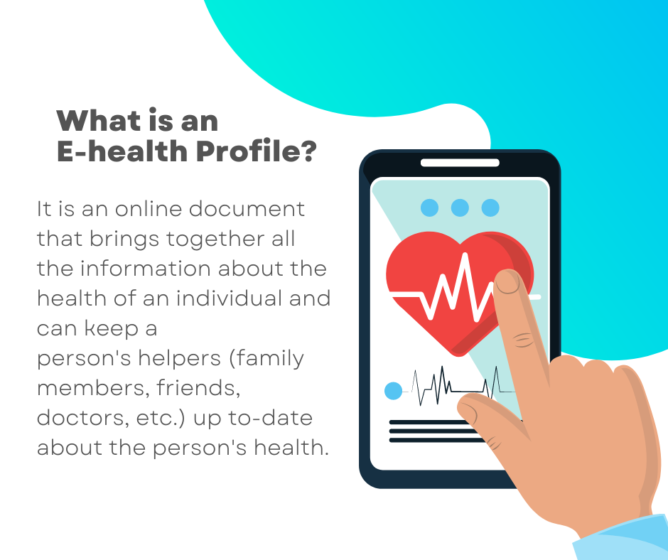
Now let’s see it in practice…
2021-1-IT02-KA220-ADU-000035139
34

Slide 35
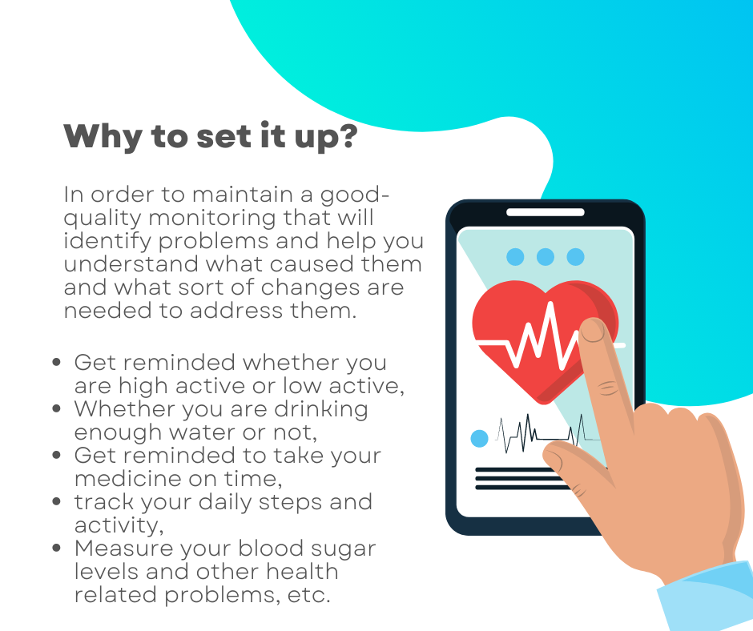
2021-1-IT02-KA220-ADU-000035139
In class Activity 3: Set up your e-Health Profile
35

Slide 36
2021-1-IT02-KA220-ADU-000035139
In class Activity 3: Set up your e-Health Profile
How easy is to set it up?
The following instructions will guide you to do so. Keep paying attention!
At the end you will be able to track and monitor your health data and receive reminder notifications about your medication(s).
*These instructions are addressed
to iPhone users*
36

Slide 37
2021-1-IT02-KA220-ADU-000035139
In class Activity 3: Set up your e-Health Profile
Are you an iOS user?
You can follow the instructions on the next slide ☺
37

Slide 38
Do you know how to set up your e-Health Profile?
2021-1-IT02-KA220-ADU-000035139
38

Slide 39
Do you know how to set up your e-Health Profile?
2021-1-IT02-KA220-ADU-000035139
Note I: You can also set up your Medical ID by adding medical conditions, allergies & reactions, or medications, or register to be an organ donor from your profile.
Note II: You can also add emergency contacts. Emergency contacts will receive a message saying that you have called emergency services when you use Emergency SOS. Your current location will be included in these messages
39

Slide 40
Do you know how to set up your e-Health Profile?
2021-1-IT02-KA220-ADU-000035139
40

Slide 41
Do you know how to set up your e-Health Profile?
2021-1-IT02-KA220-ADU-000035139
🎇 Congratulations! You did it! 🎇
Did you have a hard time when setting up your Health Profile?
Do you think it is helpful? Why?
41

Slide 42
2021-1-IT02-KA220-ADU-000035139
In class Activity 3: Set up your e-Health Profile
Are you an Android user?
You can follow the instructions on the next slide ☺
42

Slide 43
Do you know how to set up your e-Health Profile?
2021-1-IT02-KA220-ADU-000035139
Step 1: Search for health and fitness applications on the Google Play Store and read reviews and descriptions to find one that suits your needs. Popular options include Google Fit, Samsung Health, MyFitnessPal, or Fitbit.
Step 2: Once you've decided on an app, tap the "Install" button on its Google Play Store page and wait for it to download and install on your Android device.
Step 3: Open the App and look for an option like "Sign Up," "Register," or "Create Account“. Then, follow the on-screen instructions to provide the necessary information, such as your email address, username, and password.
43

Slide 44
Do you know how to set up your e-Health Profile?
2021-1-IT02-KA220-ADU-000035139
Step 4: Once you've created an account or logged in, the app will usually guide you through the process of setting up your health profile. You may be asked to enter details such as your age, gender, height, weight, and activity level.
Step 5: If you have any compatible fitness trackers, smartwatches, or other wearables, you may have the option to connect them to the app. This enables more accurate data tracking and provides a holistic view of your health and fitness.
Step 6: Once you've set up your health profile, take some time to explore the app's features. Familiarize yourself with the app's interface and start using it to track and monitor your health progress.
44

Slide 45
Do you know how to set up your e-Health Profile?
2021-1-IT02-KA220-ADU-000035139
🎇 Congratulations! You did it! 🎇
Did you have a hard time when setting up your Health Profile?
Do you think it is helpful? Why?
45

Slide 46
Project No: 2021-1-DE02-KA220-VET-000030542
Thank you!
Follow us on Facebook!
Project No: 2021-1-IT02-KA220-ADU-000035139

