Slide 1
e-government activities
e-participation
“Funded by the European Union. Views and opinions expressed are however those of the author(s) only and do not necessarily reflect those of the European Union or the European Education and Culture Executive Agency (EACEA). Neither the European Union nor EACEA can be held responsible for them.”
Project No: 2021-1-IT02-KA220-ADU-000035139

Slide 2
1. Introductory activity
2021-1-IT02-KA220-ADU-000035139
1.1. Discussion
Are you aware of the term e-participation?
Have you ever heard about it?
In what ways can it be practiced?
Why do you think it is important for a functioning democratic society?
1
Developed by p-consulting | April 2023

Slide 3
1. Introductory presentation
2021-1-IT02-KA220-ADU-000035139
1.2. Citizen participation
Citizen participation is a crucial component of a healthy and functioning democracy. It allows citizens to have a voice in decision-making processes and helps to ensure that government policies and actions reflect the needs and values of the community.
Traditionally, citizen participation has taken the form of town hall meetings, public hearings, and other in-person events. However, with the advent of digital technologies, e-participation has become an increasingly important and popular form of citizen participation.
2
Developed by p-consulting | April 2023

Slide 4
1. Introductory presentation
2021-1-IT02-KA220-ADU-000035139
1.3. e-participation
e-participation involves the use of digital platforms and tools, such as the internet, social media, and mobile devices, to engage citizens in political and democratic processes. It enables citizens to participate in decision-making from the comfort of their own homes, share their views with a wider audience, and collaborate with others on issues that affect their communities.
e-participation can take many forms, including online consultations, surveys, forums, and feedback mechanisms.
3
Developed by p-consulting | April 2023

Slide 5
1. Introductory presentation
2021-1-IT02-KA220-ADU-000035139
1.4. e-participation & e-government
e-participation is a form of e-government service that specifically focuses on citizen participation in decision-making processes. Unlike other e-government services, such as online payment systems, e-participation aims to engage citizens in collaborative dialogue and decision-making, rather than simply providing them with information or enabling them to carry out transactions.
While e-participation is just one form of e-government service, it is an important one, as it can help to foster greater transparency, accountability, and citizen engagement in government decision-making. By giving citizens a voice in policy-making processes, e-participation can help to build trust between citizens and government and ensure that policies and initiatives are responsive to the needs and values of the community.
Developed by p-consulting | April 2023
4

Slide 6
1. Introductory presentation
2021-1-IT02-KA220-ADU-000035139
1.5. Do you know any of the following platforms?
CitizenLab - A platform that allows citizens to submit ideas, vote on proposals, and provide feedback on policies and initiatives.
Change.org: A platform that enables citizens to create and sign petitions on a wide range of issues.
Your Priorities: A platform that allows citizens to submit ideas, vote on proposals, and collaborate with others on policy solutions.
Decidim – A platform that enables citizens to participate in public consultations, engage with their local governments, and contribute to policy-making processes.
5
Developed by p-consulting | April 2023

Slide 7
2. e-participation
2021-1-IT02-KA220-ADU-000035139
2.1. Brainstorming
When and why, do you think, participating got digital?
Why is it important?
6
Developed by p-consulting | April 2023

Slide 8
3. Case study
2021-1-IT02-KA220-ADU-000035139
The current activity will allow learners to develop a concrete perception of e-participation and familiarize with its practices and importance.
7
Developed by p-consulting | April 2023

Slide 9
4. Exercise
2021-1-IT02-KA220-ADU-000035139
4.1. The guidelines of the activity
The objective of this exercise is to help us understand and experience the importance of actively participating in decision-making processes. It aims to develop our critical thinking, collaboration, and communication skills, and empower us to become effective contributors to decision-making within a group or organization.
You will have to form two teams.
Each team will receive several props.
Each prop has a word related to e-government services.
We will focus on e-participation props.
First team to do so, wins.
8
Developed by p-consulting | April 2023
Notes:
You will have to form two teams.
The educator distributes several props to each team.
Each prop has a word related to e-government services.
You will have to group the props related only to e-participation.
First team to do so, wins.

Slide 10
4. Exercise
2021-1-IT02-KA220-ADU-000035139
4.2. e-government services
1. Online consultation platform
2. e-procurement platform for government contracts
3. Digital public records archive
4. Electronic voting system
5. Crowdsourcing tool for policy ideas
9
Developed by p-consulting | April 2023

Slide 11
4. Exercise
2021-1-IT02-KA220-ADU-000035139
4.2. e-government services
6. Online petition platform
7. Online payment system for taxes and fees
8. Collaborative decision-making software
9. Digital citizen survey tool
10. Online platform for citizen complaints and feedback
10
Developed by p-consulting | April 2023

Slide 12
4. Exercise
2021-1-IT02-KA220-ADU-000035139
4.3. Discussion topic
Which of the given e-government services are related to e-participation?
Please justify your answer.
11
Developed by p-consulting | April 2023

Slide 13
4. Exercise
2021-1-IT02-KA220-ADU-000035139
4.4. Become a part of decision-making processes!
As learners-citizens we’ll take time to read and understand the given topic and eventually we’ll provide a justified response.
Thus, we become engaged with the concept of e-participation and build a solid understanding around its ecosystem.
12
Developed by p-consulting | April 2023

Slide 14
4. Exercise
2021-1-IT02-KA220-ADU-000035139
4.5. Evaluation and Reflection
Was the digital platform user-friendly and easy for you to use?
Are you planning to use e-participation platforms in the future?
What is your opinion on the use of e-participation platforms? Have you found them to be effective in increasing citizen engagement and participation in the policymaking process?
Do you believe they have the potential to improve transparency, accountability, and citizen engagement in government decision-making?
13
Developed by p-consulting | April 2023

Slide 15
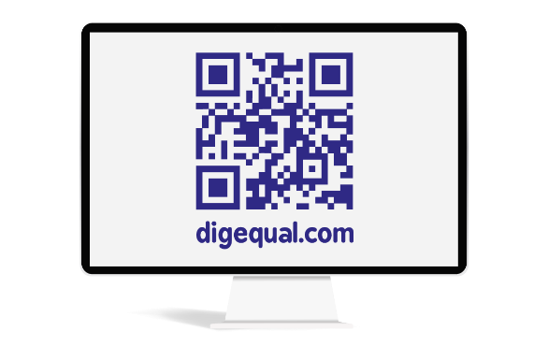
Project No: 2021-1-DE02-KA220-VET-000030542
Thank you!
Follow us on Facebook!
https://www.facebook.com/digequalproject
Funded by the European Union. Views and opinions expressed are however those of the author(s) only and do not necessarily reflect those of the European Union or the European Education and Culture Executive Agency (EACEA). Neither the European Union nor EACEA can be held responsible for them.
Project No: 2021-1-IT02-KA220-ADU-000035139
Developed by p-consulting | April 2023

Slide 16
e-government activities
e-policy Making
(Activity 2)
“Funded by the European Union. Views and opinions expressed are however those of the author(s) only and do not necessarily reflect those of the European Union or the European Education and Culture Executive Agency (EACEA). Neither the European Union nor EACEA can be held responsible for them.”
Project No: 2021-1-IT02-KA220-ADU-000035139
Developed by p-consulting | April 2023

Slide 17
1. Introductory activity
2021-1-IT02-KA220-ADU-000035139
1.1. Discussion
The concept of policy making may be familiar to you, but have you considered its significance?
Why is policy making important?
Have you ever practiced it?
In what ways can it be practiced digitally?
1
Developed by p-consulting | April 2023

Slide 18
1. Introductory presentation
2021-1-IT02-KA220-ADU-000035139
1.2. Policy making
Policy making refers to the process of creating and implementing policies to address specific issues or achieve particular goals. This process involves a series of steps, including problem identification, agenda setting, policy formulation, adoption, implementation, and evaluation.
Effective policy making requires collaboration, consultation, and engagement with stakeholders, as well as the use of evidence-based approaches to inform decision-making. Good policies are those that are feasible, effective, and efficient, and that reflect the values and aspirations of society as a whole.
2
Developed by p-consulting | April 2023

Slide 19
1. Introductory presentation
2021-1-IT02-KA220-ADU-000035139
1.3. e-policy making
e-policy making provides citizens with a platform to express their opinions, concerns, and feedback on policy issues. Through digital tools, citizens can share their views and ideas with policymakers and other members of the community. This engagement helps to increase transparency, accountability and public trust in the policymaking process.
e-policy making also enables citizens to become part of an online community where they can interact with like-minded individuals, share their experiences, and collaborate on policy initiatives.
3
Developed by p-consulting | April 2023

Slide 20
1. Introductory presentation
2021-1-IT02-KA220-ADU-000035139
1.4. Do you know any of the following platforms?
eDemocracy platform of the European Commission - a platform that allows citizens to submit feedback and ideas on EU policies, initiatives and legislative proposals.
CONSUL - a platform developed by the city of Madrid, Spain, that allows citizens to participate in decision-making processes and collaborate with public institutions.
CitizenLab - a platform used by several EU cities to engage citizens in policymaking and crowdsource ideas.
OurSpace - a platform developed by the European Youth Forum that allows young people to participate in EU policy-making and share their opinions on youth-related issues.
Decidim – a participatory democracy platform for cities and organizations.
MyBB – a forum software powering thousands of engaging, vibrant, and unique communities across the internet.
4
Developed by p-consulting | April 2023

Slide 21
2. e-policy making platform
2021-1-IT02-KA220-ADU-000035139
2.1. Brainstorming
What would you think of the idea of a platform allowing you to participate in a subject of public interest?
Did you ever have an idea for a policy that you think would benefit the community but didn’t know where and how to address it?
5
Developed by p-consulting | April 2023

Slide 22
3. Case study
2021-1-IT02-KA220-ADU-000035139
3.1. Step by step:
A city government has recently launched an e-policy platform to engage citizens in the policymaking process. One day, a citizen named Jane logs onto the platform to submit a proposal. She notices that there is a section on the platform where citizens can introduce their own ideas for policies that they think would benefit the community.
Jane decides to submit an idea she has been thinking about for a while: she suggests that the city government should invest in a new park in her neighborhood. She believes that the area lacks green space and that a new park would provide residents with a place to relax, exercise, and socialize.
6
Developed by p-consulting | April 2023

Slide 23
3. Case study
2021-1-IT02-KA220-ADU-000035139
3.1. Step by step:
Jane fills out the submission form on the e-policy platform, describing her proposal and why she thinks it's important. She also includes some pictures of the neighborhood to illustrate her point.
The platform automatically sends Jane's proposal to the relevant government officials and posts it publicly on the platform for other citizens to view and comment on. Within a few days, several other residents in Jane's neighborhood have commented on her proposal, expressing their support and adding their own suggestions for features they would like to see in the new park.
7
Developed by p-consulting | April 2023

Slide 24
3. Case study
2021-1-IT02-KA220-ADU-000035139
3.1. Step by step:
The city government officials responsible for parks and recreation also see Jane's proposal and decide to hold a public meeting to discuss the idea further. They invite Jane and other interested citizens to attend the meeting and share their thoughts on the proposal.
Thanks to the e-policy platform, Jane's idea has gained traction and sparked a conversation about the need for more green space in the neighborhood. The city government officials take the proposal seriously and ultimately decide to allocate funding for a new park in Jane's neighborhood, incorporating some of the suggestions made by other residents.
8
Developed by p-consulting | April 2023

Slide 25
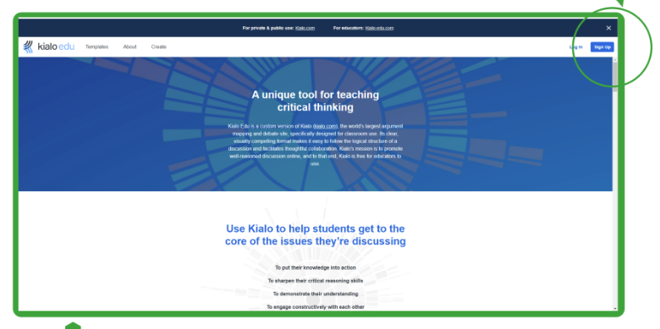
4. Exercise
2021-1-IT02-KA220-ADU-000035139
4.1. Digital policy making platform
1. Go to https://www.kialo-edu.com
2. Click the blue button to sign up, or the “log in” button, if you already have an account.
Note: You can use a smartphone, a tablet or a desktop/laptop computer.
9
Developed by p-consulting | April 2023

Slide 26
4. Exercise
2021-1-IT02-KA220-ADU-000035139
4.2. Register as a new user
Follow the steps to sign up.
You will need to fill in the following:
Name
Email (optional)
Password
10
Developed by p-consulting | April 2023

Slide 27
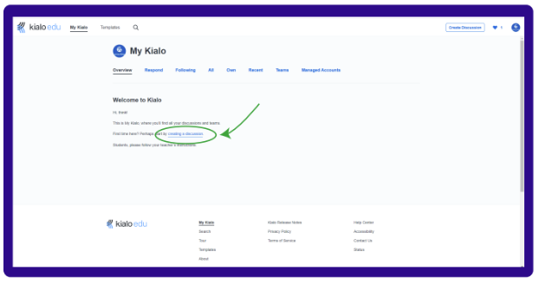
4. Exercise
2021-1-IT02-KA220-ADU-000035139
4.3. Start a discussion
Click the link to initiate a discussion.
11
Developed by p-consulting | April 2023

Slide 28
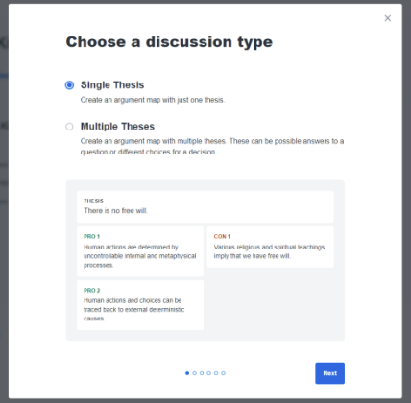
4. Exercise
2021-1-IT02-KA220-ADU-000035139
4.4. Discussion topic
Choose the specifics of the discussion:
A. Discussion Type
12
Developed by p-consulting | April 2023

Slide 29
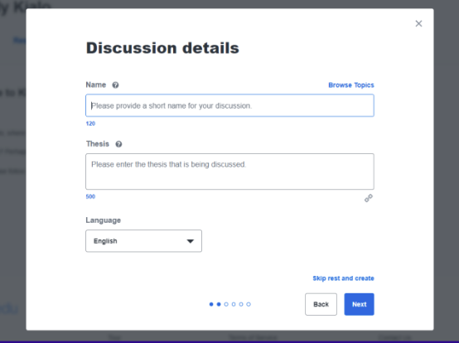
4. Exercise
2021-1-IT02-KA220-ADU-000035139
4.4. Discussion topic
Choose the specifics of the discussion:
B. Discussion details
13
Developed by p-consulting | April 2023

Slide 30
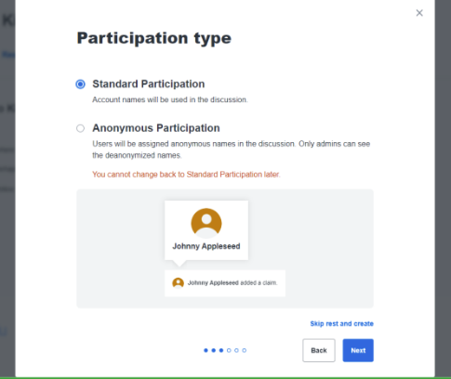
4. Exercise
2021-1-IT02-KA220-ADU-000035139
4.4. Discussion topic
Choose the specifics of the discussion:
C. Participation type
14
Developed by p-consulting | April 2023

Slide 31
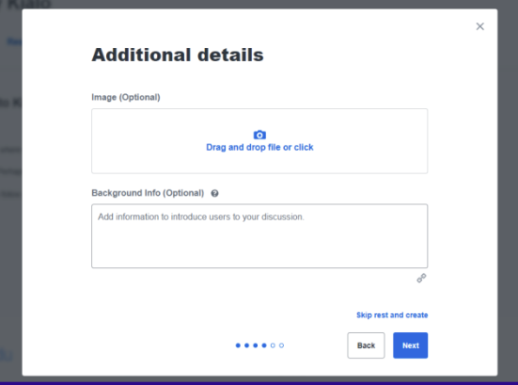
4. Exercise
2021-1-IT02-KA220-ADU-000035139
4.4. Discussion topic
Choose the specifics of the discussion:
D. Add any additional details (optional)
15
Developed by p-consulting | April 2023

Slide 32
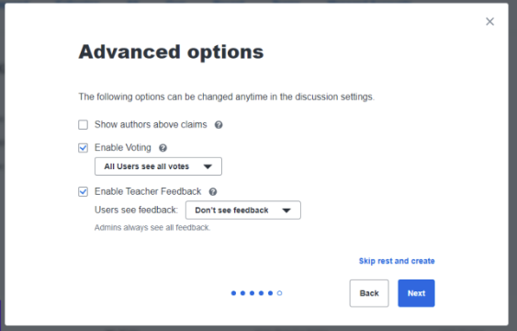
4. Exercise
2021-1-IT02-KA220-ADU-000035139
4.4. Discussion topic
Choose the specifics of the discussion:
E. Advanced options
You can select whether the voting results will be visible to all users and/or whether the users will be able to see the educator’s feedback.
16
Developed by p-consulting | April 2023

Slide 33
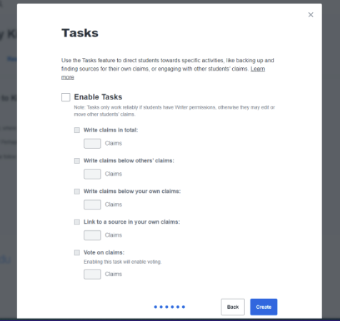
4. Exercise
2021-1-IT02-KA220-ADU-000035139
4.5. Become a part of policy-making!
The users-citizens take time to read and understand the given topic and are eventually asked to provide a positive/negative response and elaborate on an alternative/why they think it is a good proposal.
17
Developed by p-consulting | April 2023

Slide 34
4. Exercise
2021-1-IT02-KA220-ADU-000035139
4.6. Evaluation and Reflection
Was the digital platform user-friendly and easy for you to use?
Are you planning to use digital policy making platforms in the future?
What is your opinion on the use of e-policy making platforms? Have you found them to be effective in increasing citizen engagement and participation in the policymaking process?
Do you believe they have the potential to improve transparency, accountability, and inclusivity in decision-making?
18
Developed by p-consulting | April 2023

Slide 35
Project No: 2021-1-DE02-KA220-VET-000030542
Thank you!
Follow us on Facebook!
https://www.facebook.com/digequalproject
Funded by the European Union. Views and opinions expressed are however those of the author(s) only and do not necessarily reflect those of the European Union or the European Education and Culture Executive Agency (EACEA). Neither the European Union nor EACEA can be held responsible for them.
Project No: 2021-1-IT02-KA220-ADU-000035139
Developed by p-consulting | April 2023

Slide 36
e-government activities
e-voting
(Activity 1)
“Funded by the European Union. Views and opinions expressed are however those of the author(s) only and do not necessarily reflect those of the European Union or the European Education and Culture Executive Agency (EACEA). Neither the European Union nor EACEA can be held responsible for them.”
Project No: 2021-1-IT02-KA220-ADU-000035139
Developed by p-consulting | April 2023

Slide 37
1. Introductory activity
2021-1-IT02-KA220-ADU-000035139
1.1. Discussion
Is distance a deterrent factor when it comes to voting?
How long do you usually wait in queues?
Are there any trust issues?
1
Developed by p-consulting | April 2023

Slide 38
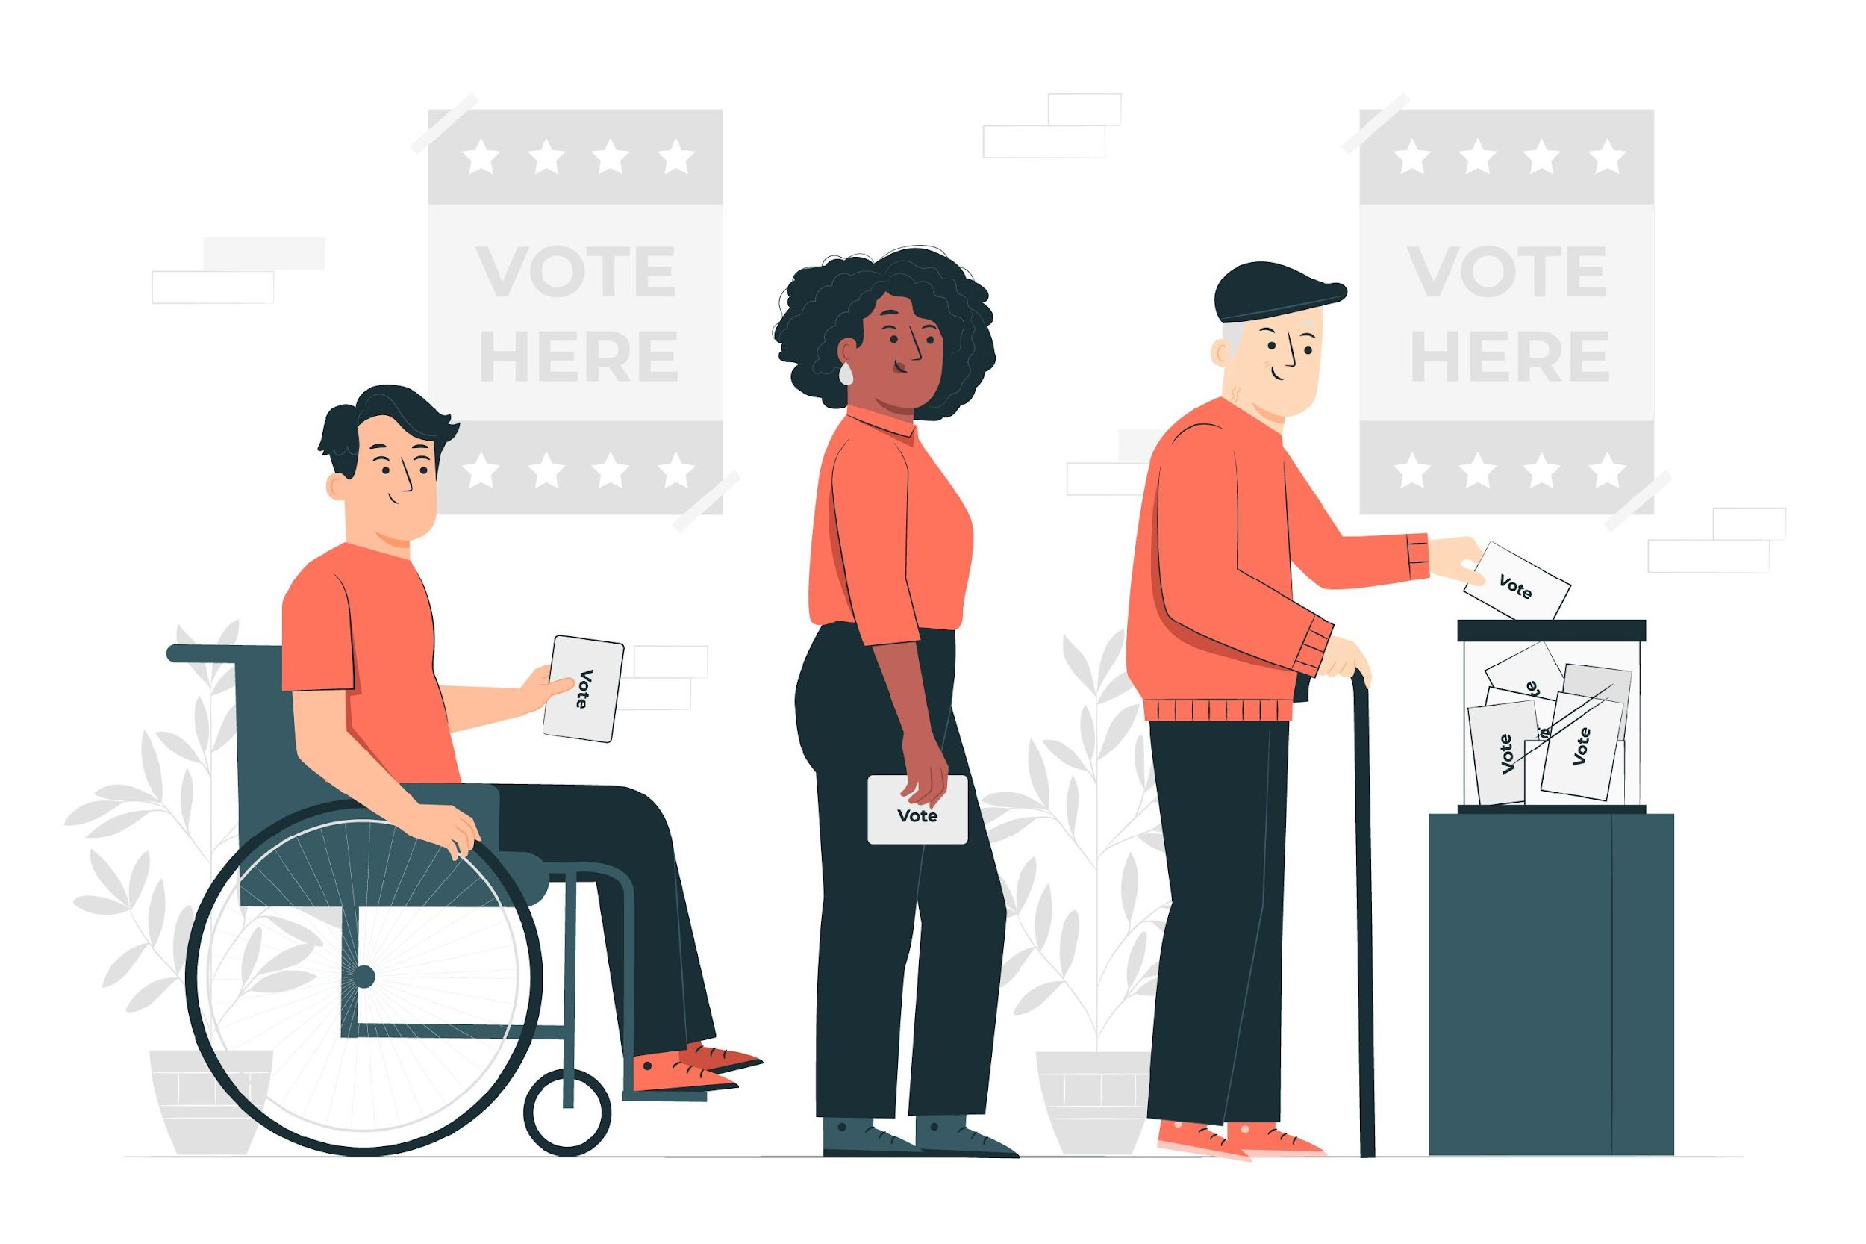
2. Comparative exercise
2021-1-IT02-KA220-ADU-000035139
2.1. Traditional voting (physical presence)
Traditional voting requires the physical presence of citizens. It is performed in designated polling places where the voters cast their ballots, typically made of paper.
The voting process is conducted by trained election officials who ensure that the process is fair and transparent.
2
Developed by p-consulting | April 2023

Slide 39
2. Comparative exercise
2021-1-IT02-KA220-ADU-000035139
2.2. e-voting
Through e-voting, citizens are able to participate in a voting procedure digitally, from the comfort of their own space.
Political elections, Universities, or work, it can be applied everywhere and save time and budget!
3
Developed by p-consulting | April 2023

Slide 40
2. Comparative exercise
2021-1-IT02-KA220-ADU-000035139
2.3. Why is the traditional voting method still applied nowadays?
Despite the wide use and advancement of technology, traditional voting remains the first option in a voting process.
Many countries have legal requirements that mandate the use of traditional voting methods. Changing the voting process would require significant legislative and administrative efforts.
Moreover, traditional voting has a social and cultural significance, providing a physical manifestation of democracy that is shared by many citizens. Traditional voting has been used for centuries, and many people trust it as a reliable and familiar method for casting their vote.
4
Developed by p-consulting | April 2023

Slide 41
2. Comparative exercise
2021-1-IT02-KA220-ADU-000035139
2.4. Which are the disadvantages of traditional voting?
While traditional voting has its advantages, it also has weaknesses that can result in a significant rate of abstention or non-participation by eligible voters. Some of these weaknesses include limited accessibility, potential for long wait times, and limited flexibility in terms of voting hours and locations.
These factors can discourage some voters from participating in the democratic process, resulting in lower voter turnout.
5
Developed by p-consulting | April 2023

Slide 42
2. Comparative exercise
2021-1-IT02-KA220-ADU-000035139
2.5. How does the e-voting work? Why should I choose this, instead of traditional voting?
e-voting, or electronic voting, is a voting system that allows voters to cast their ballots electronically instead of using traditional paper-based voting methods. There are various types of e-voting systems, including online voting, touch-screen voting machines, and optical scan voting systems.
During e-voting, voters use electronic devices, such as computers or touch screens, to cast their votes. These votes are then recorded and counted electronically, using specialized software and hardware.
6
Developed by p-consulting | April 2023

Slide 43
2. Comparative exercise
2021-1-IT02-KA220-ADU-000035139
2.5. How does the e-voting work? Why should I choose this, instead of traditional voting?
Online voting is:
Convenient: it allows people to vote from the comfort of their own homes/spaces
Accessible: easier to use for people with disabilities or limited literacy
Accurate: the electronic systems can automatically check for errors and ensure that all votes are counted correctly.
Time shaving: no need to stand in long queues
7
Developed by p-consulting | April 2023

Slide 44
3. Case study
2021-1-IT02-KA220-ADU-000035139
3.1. Step by step:
The local community council is facing a difficult decision about how to allocate funds for a new park development project. There are two main proposals on the table: one for a playground and sports fields, and another for a community garden and walking trail.
The participants in the voting exercise are the members of the community council, as well as a group of stakeholders who have an interest in the park development project. The stakeholders include local residents, business owners, park users, and other relevant groups.
8
Developed by p-consulting | April 2023

Slide 45
3. Case study
2021-1-IT02-KA220-ADU-000035139
3.1. Step by step:
M.P. is a member of the community who is eligible to participate in the decision-making process, but he can’t be present in the voting, due to a professional trip that will keep him away from home for over a month. Same case applies to a few other members of his community.
The decision is crucial for the neighborhood, and they want to participate in the voting process.
9
Developed by p-consulting | April 2023

Slide 46
3. Case study
2021-1-IT02-KA220-ADU-000035139
3.2. Brainstorming
How can the voting process take place without further delay?
Is it possible for the absent members of the community to vote?
If so, how can the accuracy of the voting results be ensured?
10
Developed by p-consulting | April 2023

Slide 47
3. Case study
2021-1-IT02-KA220-ADU-000035139
Note: The right of voting for eligible members of a community is a fundamental democratic principle.
11
Developed by p-consulting | April 2023

Slide 48
3. Case study
2021-1-IT02-KA220-ADU-000035139
3.3. Brainstorming
What can the council of the community do to allow to as many members as possible to participate in such an important decision-making process?
Wait for the absent voters to return: Nevertheless, the council cannot guarantee the availability of all the members of a community at a specific date.
Conduct the voting with the present voters: This, however, will deprive the other members from exercising the right to vote in a decision that involves them directly.
12
Developed by p-consulting | April 2023

Slide 49
4. Surmount traditional voting challenges
2021-1-IT02-KA220-ADU-000035139
4.1. Adopt e-voting
Since M.P. and other absent members are eligible voters of the community, the voting process can be carried out online.
The local community council could use an e-voting platform, such as electobox or electionrunner, to conduct the voting process.
13
Developed by p-consulting | April 2023

Slide 50
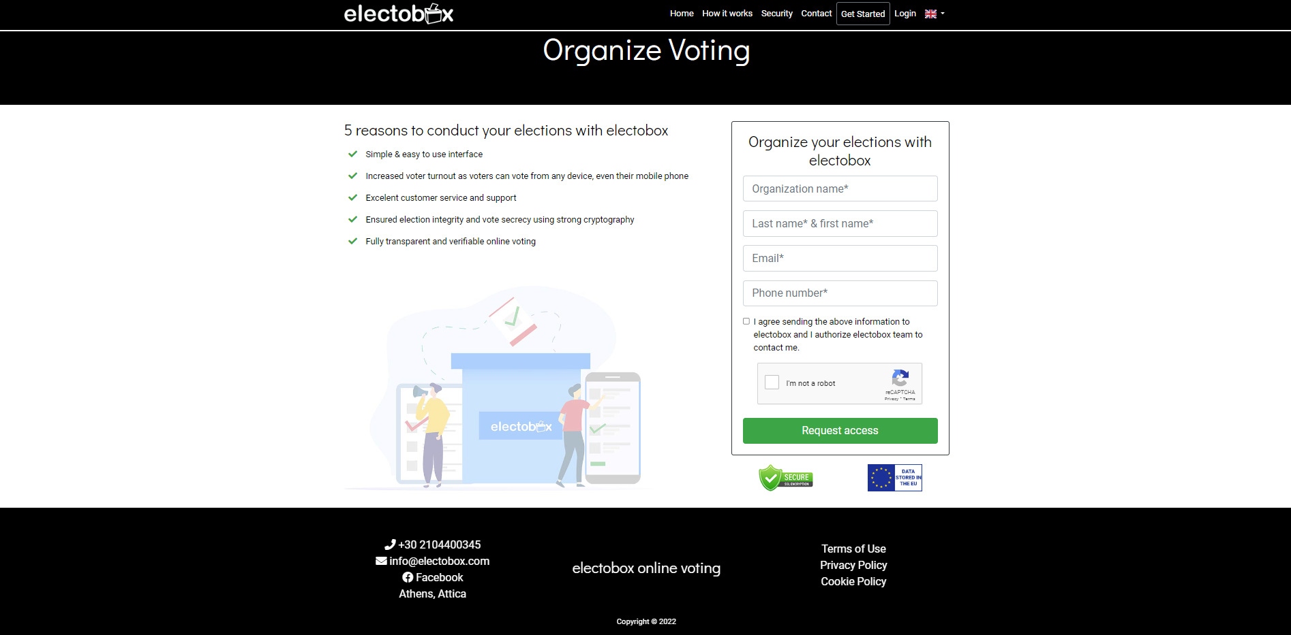
5. Exercise
2021-1-IT02-KA220-ADU-000035139
5.1 Create a voting process profile
1. Go to www.electobox.com
2. Fill in the required fields:
Organization name
Last name and first name
Email
Phone number
3. Click the consent checkbox.
4. Press the Request access button.
14
Developed by p-consulting | April 2023

Slide 51
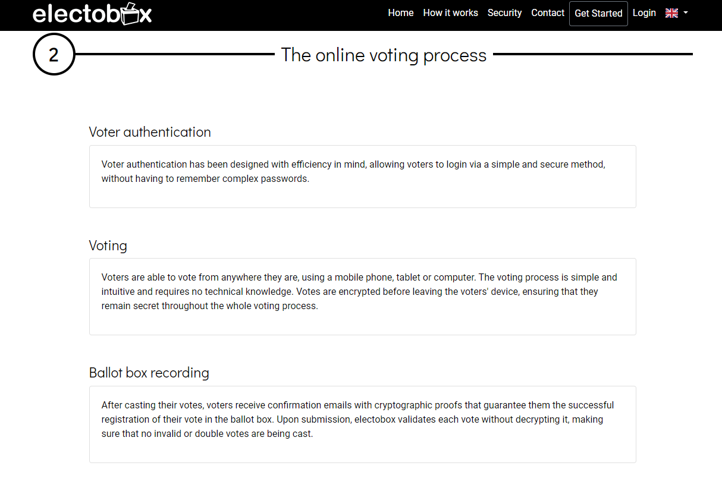
5. Exercise
2021-1-IT02-KA220-ADU-000035139
5.2. Voter authentication
Follow the steps to register as a voter.
You can use a smartphone, a tablet or a desktop/laptop computer.
15
Developed by p-consulting | April 2023

Slide 52
5. Exercise
2021-1-IT02-KA220-ADU-000035139
5.3. Voting process
Follow the instructions to vote.
16
Developed by p-consulting | April 2023

Slide 53
5. Exercise
2021-1-IT02-KA220-ADU-000035139
5.4. Confirmation of the successful submission of your vote
After casting your vote, you will receive a confirmation email with cryptographic proof guaranteeing that your vote has been received and counted in the election.
17
Developed by p-consulting | April 2023

Slide 54
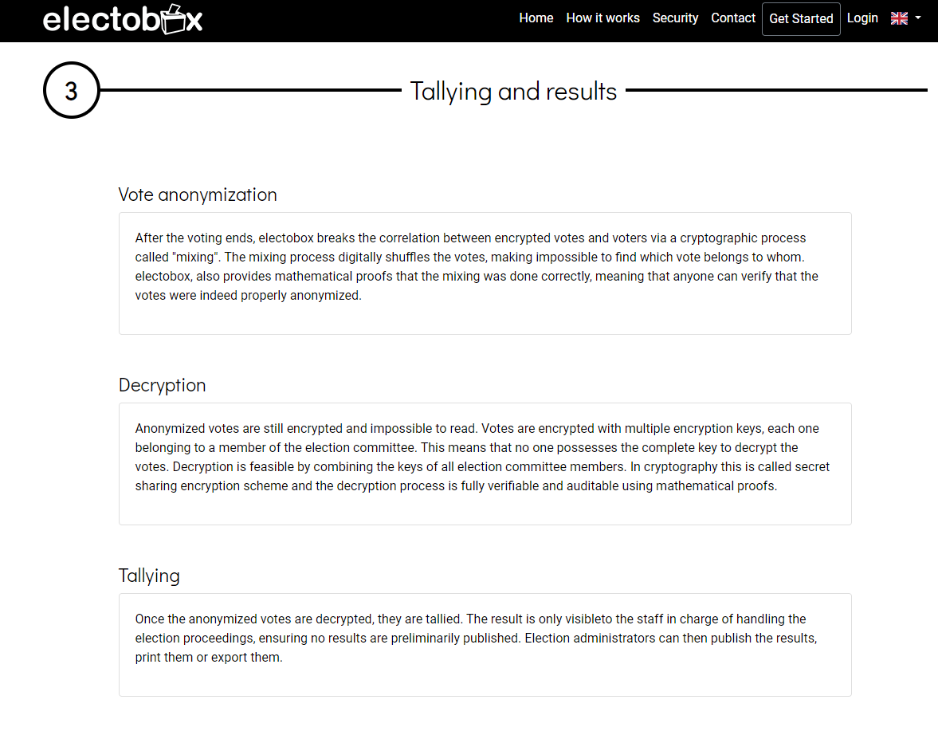
5. Exercise
2021-1-IT02-KA220-ADU-000035139
5.5. End of the e-voting process
After the voting ends, the electobox platform digitally shuffles the votes in a way that makes it impossible to identify which vote belongs to which voter. To ensure the accuracy of the mixing process, electobox provides mathematical proofs that can be verified by anyone to confirm that the votes were properly anonymized.
18
Developed by p-consulting | April 2023

Slide 55
Project No: 2021-1-DE02-KA220-VET-000030542
Thank you!
Follow us on Facebook!
https://www.facebook.com/digequalproject
Funded by the European Union. Views and opinions expressed are however those of the author(s) only and do not necessarily reflect those of the European Union or the European Education and Culture Executive Agency (EACEA). Neither the European Union nor EACEA can be held responsible for them.
Project No: 2021-1-IT02-KA220-ADU-000035139
Developed by p-consulting | April 2023

