Slide 1
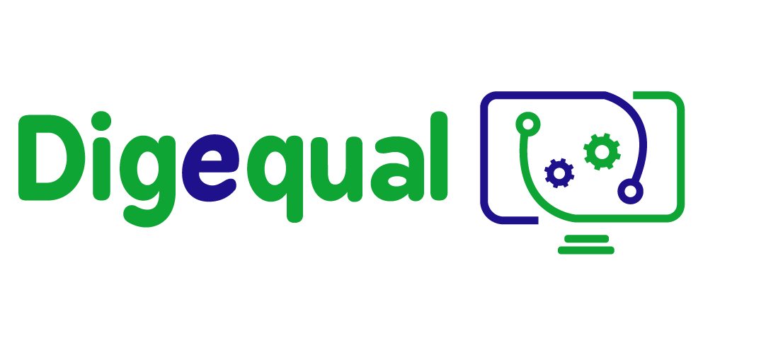
The 101 of e-payment –
Basics for everyday usage
Lesson 1.
Introducing e-payment
Funded by the European Union. Views and opinions expressed are however those of the author(s) only and do not necessarily reflect those of the European Union or the European Education and Culture Executive Agency (EACEA). Neither the European Union nor EACEA can be held responsible for them.
Project No: 2021-1-IT02-KA220-ADU-000035139
This project has been funded with the support of the European Commission. This publication reflects the views only of the author and the Commission cannot be held responsible for any use which may be made of the information contained therein.

Slide 2
1.1 Introducing e-payment
2021-1-IT02-KA220-ADU-000035139
What is e-payment?
E-payment stands for electronic payment.
E-payment is a transaction made through the internet or other electronic means instead of using cash or check.
2

Slide 3
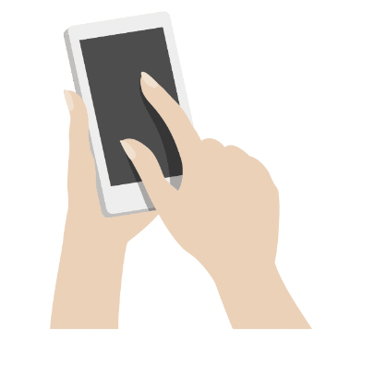
1.2 E-payment in everyday life
2021-1-IT02-KA220-ADU-000035139
How can I use e-payment services in my daily life?
You can pay for concert tickets online.
You can buy a book online.
You can pay the invoice for the car repair online.
You can easily send money to friends or your family.
3

Slide 4
Who has used e-payment in the past?
2021-1-IT02-KA220-ADU-000035139
Have | Would love to, but I have concerns. | Have not
4

Slide 5
1.3 Self-assessment
2021-1-IT02-KA220-ADU-000035139
How much do you know about e-payment and e-payment methods?
How comfortable are you with using various methods?
Do you feel autonomous in paying online?
Fill in the self-assessment to find out
how confident you are with these tools
5

Slide 6
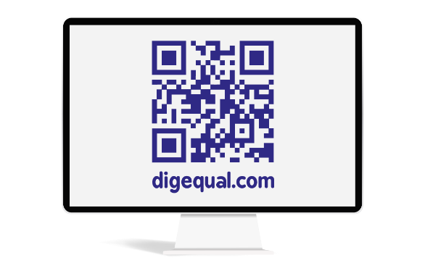
Project No: 2021-1-DE02-KA220-VET-000030542
Thank you!
Follow us on Facebook!
Project No: 2021-1-IT02-KA220-ADU-000035139

Slide 7
e-payment
Lesson 2.
Benefits & drawbacks
Funded by the European Union. Views and opinions expressed are however those of the author(s) only and do not necessarily reflect those of the European Union or the European Education and Culture Executive Agency (EACEA). Neither the European Union nor EACEA can be held responsible for them.
Developed by Polygonal | Dec, 2022
This project has been funded with the support of the European Commission. This publication reflects the views only of the author and the Commission cannot be held responsible for any use which may be made of the information contained therein.
Project No: 2021-1-IT02-KA220-ADU-000035139

Slide 8
Why is e-payment relevant?
2021-1-IT02-KA220-ADU-000035139
Technology is becoming more and more important in our daily lives, including how we pay for things
Being able to use digital payment options can give you many benefits and advantages when paying for services online
It's important to learn how to use these options so you can make the most of what technology has to offer.
8

Slide 9
2.1 Advantages of e-payment systems
2021-1-IT02-KA220-ADU-000035139
What comes to your mind
when thinking about benefits of
e-payment systems?
9

Slide 10
2.1 Advantages of e-payment systems
2021-1-IT02-KA220-ADU-000035139
They are convenient.
E-payment systems are often more convenient than traditional payment methods because they allow users to make or receive payments quickly and easily without needing cash or checks.
For example, with a digital wallet, users can make purchases or transfer funds simply by tapping their phone or using a pin code rather than carrying around physical money or filling out paperwork.
10

Slide 11
2.1 Advantages of e-payment systems
2021-1-IT02-KA220-ADU-000035139
They are speedy.
E-payment systems can process transactions almost instantly, allowing users to make or receive payments quickly and without delay.
11

Slide 12
2.1 Advantages of e-payment systems
2021-1-IT02-KA220-ADU-000035139
They help you access services all across the globe.
E-payment systems allow transferring money across borders without needing actual currency, making it simpler for people to buy from companies abroad.
12

Slide 13
2.1 Advantages of e-payment systems
2021-1-IT02-KA220-ADU-000035139
They decrease physical risks.
E-payment systems can be more secure than traditional payment methods because you don’t have to worry about counterfeit money or being robbed.
13

Slide 14
2.2 Drawbacks of e-payment systems
2021-1-IT02-KA220-ADU-000035139
What comes to your mind
when thinking about potential
drawbacks of e-payment systems?
14

Slide 15
2.2 Drawbacks of e-payment systems
2021-1-IT02-KA220-ADU-000035139
You are dependent on technology.
E-payment systems rely on technology, making them vulnerable to technical failures or disruptions. For example, if a digital wallet system experiences a server outage, users may be unable to access their accounts or make payments.
15

Slide 16
2.2 Drawbacks of e-payment systems
2021-1-IT02-KA220-ADU-000035139
You need to have the right tools & knowledge to use e-payment systems.
E-payment systems can be difficult to use for people who do not have access to electronic devices, such as computers or smartphones. This can exclude certain segments of the population from using e-payment systems, which can limit their adoption and usefulness.
16

Slide 17
2.2 Drawbacks of e-payment systems
2021-1-IT02-KA220-ADU-000035139
Collection of data.
Everytime you use an e-payment service you create data. It is hard to track what information is gathered and used when using e-payment systems.
17

Slide 18
2.2 Drawbacks of e-payment systems
2021-1-IT02-KA220-ADU-000035139
Risk of security breaches and fraud.
Because e-payment systems involve the transfer of sensitive financial information, they are often targets for hackers and other cybercriminals who seek to steal or use this information for illegal purposes.
18

Slide 19
2.2 Wrap up advantages & drawbacks
2021-1-IT02-KA220-ADU-000035139
Quiz-Time: What are the advantages or disadvantages behind the images?
19

Slide 20
2.2 Wrap up advantages & drawbacks
2021-1-IT02-KA220-ADU-000035139
Advantage:
You can buy goods globally.
20

Slide 21
2.2 Wrap up advantages & drawbacks
2021-1-IT02-KA220-ADU-000035139
Drawback: You need to have the right tools and knowledge.
21

Slide 22
2.2 Wrap up advantages & drawbacks
2021-1-IT02-KA220-ADU-000035139
Advantage:
They are fast.
22

Slide 23
2.2 Wrap up advantages & drawbacks
2021-1-IT02-KA220-ADU-000035139
Drawback:
There is the risk of security breaches.
23

Slide 24
2.2 Wrap up advantages & drawbacks
2021-1-IT02-KA220-ADU-000035139
Advantage:
Reduces risk of being physically robbed.
24

Slide 25
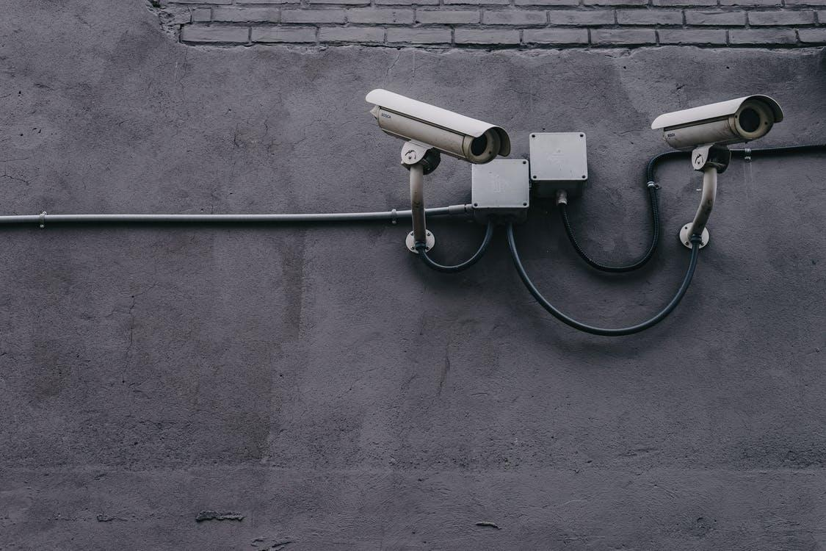
2.2 Wrap up advantages & drawbacks
2021-1-IT02-KA220-ADU-000035139
Drawback: Lots of data about you is tracked.
25

Slide 26
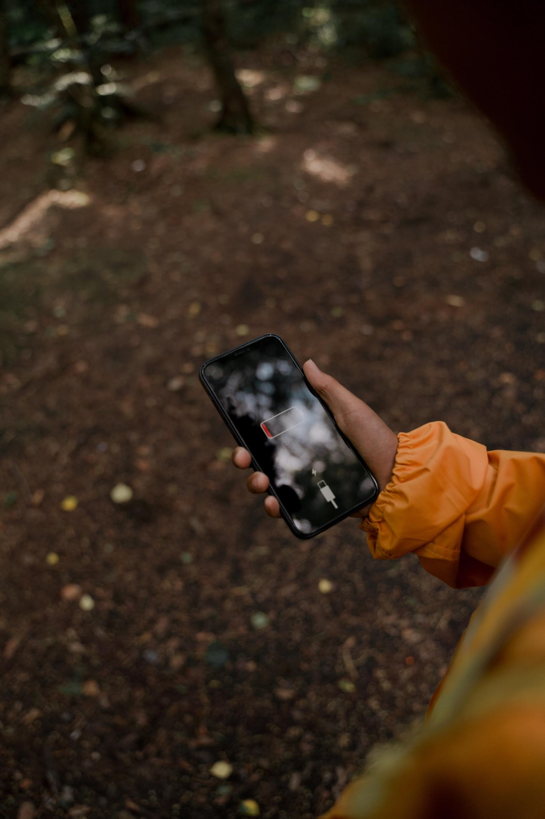
2.2 Wrap up advantages & drawbacks
2021-1-IT02-KA220-ADU-000035139
Drawback:
You are dependent on technology.
26

Slide 27
2.2 Wrap up advantages & drawbacks
2021-1-IT02-KA220-ADU-000035139
Advantage: They are very convenient.
27

Slide 28
Project No: 2021-1-DE02-KA220-VET-000030542
Thank you!
Follow us on Facebook!
Project No: 2021-1-IT02-KA220-ADU-000035139

Slide 29
e-payment
Lesson 3.
Most popular services
Funded by the European Union. Views and opinions expressed are however those of the author(s) only and do not necessarily reflect those of the European Union or the European Education and Culture Executive Agency (EACEA). Neither the European Union nor EACEA can be held responsible for them.
Developed by Polygonal | Dec, 2022
This project has been funded with the support of the European Commission. This publication reflects the views only of the author and the Commission cannot be held responsible for any use which may be made of the information contained therein.
Project No: 2021-1-IT02-KA220-ADU-000035139

Slide 30
3.1 What are the most popular services?
2021-1-IT02-KA220-ADU-000035139
Short task:
Search the web for the most popular e-payment services
Then compare your findings
Time: 5-10 minutes
30

Slide 31
3.1 What are the most popular services? - Digital wallets
2021-1-IT02-KA220-ADU-000035139
1. Digital wallets (Example: PayPal, Apple pay, Google Wallet)
A digital wallet, also known as an e-wallet or mobile wallet, is a digital version of a physical wallet that allows users to store, manage, and spend their money electronically. Some of the most popular digital wallets include PayPal, Apple Pay and Google Wallet.
You create an account that is connected to your bank account. When you want to buy something you enter your account details or use your fingerprint to allow the payment.
31

Slide 32
3.1 PayPal
2021-1-IT02-KA220-ADU-000035139
PayPal is a little different from Apple Pay and Google Pay for a couple of reasons:
you can transfer money to people directly
you can also use it via a browser like Chrome or Edge
you can link it to your bank account instead of your debit or credit card
32

Slide 33
3.1 PayPal
2021-1-IT02-KA220-ADU-000035139
However usually you cannot pay in stores via NFC; you either have to scan a PayPal QR-Code or use Google Pay that needs to be connected to your PayPal account
You need to have online banking set up to be able to use PayPal
Practical advice:
PayPal is very convenient for paying online because it is widely accepted
Often times there is an option called “PayPal Express checkout” where you don't have to enter your address because the online-shop will simply get the information from PayPal
Note: In Section 5.1 we will talk about how to set up a PayPal account.
33

Slide 34
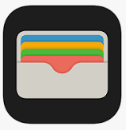
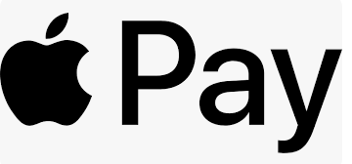
3.1 Apple Pay/Apple Wallet
2021-1-IT02-KA220-ADU-000035139
Apple wallet is a digital wallet that can be exclusively used on apple devices such as the iPhone or Apple watch
The service is called Apple pay, the app where you set up the service is called the Apple Wallet
You can only use Apple Pay if you link a credit or debit card with your Apple Wallet
Can be practical in everyday life to pay in stores via NFC
Note: In Section 5.1 we will talk about how to set up a Apple Pay.
34

Slide 35
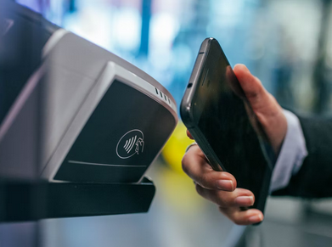
3.1 What is NFC?
2021-1-IT02-KA220-ADU-000035139
NFC = Near Field Communication - is a technology in newer phones that, among other things, allows you to pay contactless.
Is available in lots of stores like supermarkets.
You can recognise the availability by a sign that looks like this ->
Note: In Section 5.1 we will talk about how to use NFC.
35

Slide 36
3.1 Google Wallet
2021-1-IT02-KA220-ADU-000035139
Works basically like Apple Pay/Apple Wallet - just with phones that use the so called Android operating system = every Phone that is not from Apple
The service is called Google Pay, the app where you set up the service is called the Google Wallet
You can only use Google Wallet if you link a credit or debit card with your Google Wallet
Can be practical in everyday life to pay in stores via NFC
Note: In Section 5.1 we will talk about how to set up a Google Pay.
36

Slide 37
3.1 What are the most popular services?
2021-1-IT02-KA220-ADU-000035139
2. Online Banking
You need to have your account activated for online banking. You can either use the app or the website of your bank to make transactions.
37

Slide 38
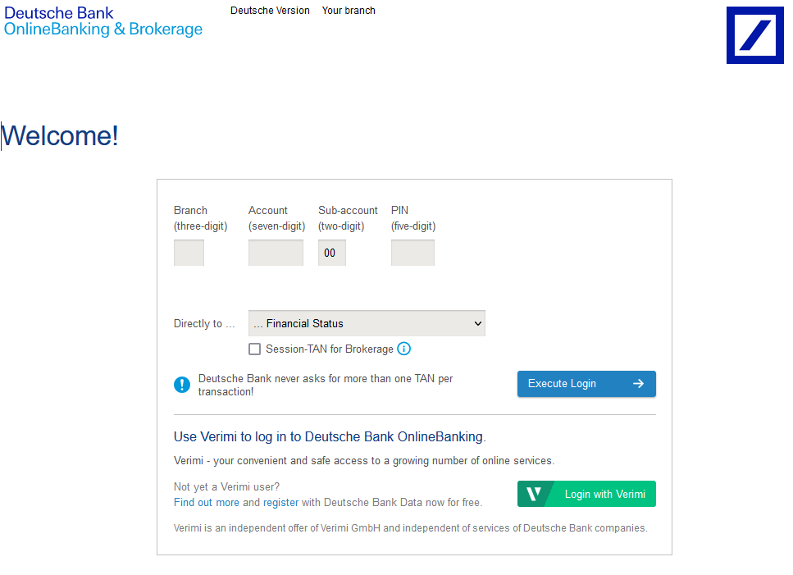
3.1 What are the most popular services? - Online-Banking
2021-1-IT02-KA220-ADU-000035139
Example Log-In screen:
38

Slide 39
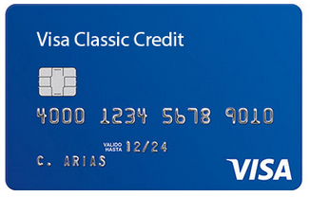
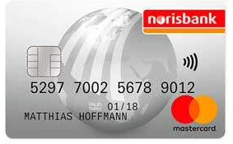
3.1 What are the most popular services?
2021-1-IT02-KA220-ADU-000035139
3. Credit Card
You can order the credit card from your bank or other providers. Allows you to borrow money from the card issuer up to a certain limit to purchase items or withdraw cash.
39

Slide 40
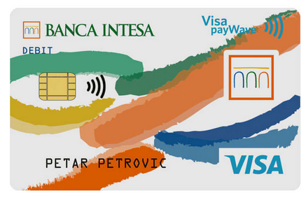
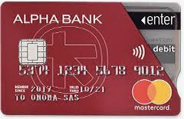
3.1 What are the most popular services?
2021-1-IT02-KA220-ADU-000035139
4. Debit Card
Usually the card you get when you open a bank account. Debit cards allow you to spend money by drawing on funds you have deposited at your bank.
Indicates whether a card supports contactless payment.
40

Slide 41
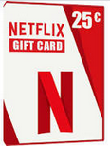
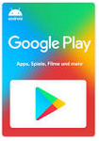
3.1 What are the most popular services?
2021-1-IT02-KA220-ADU-000035139
5. Gift cards (Example: Amazon, Netflix, Google Play, Steam)
You can get gift cards in many stores. You pay for them and use them at a later point to pay for services or goods online by entering a code that you get with the gift card.
41

Slide 42
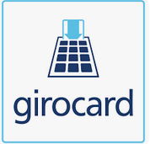
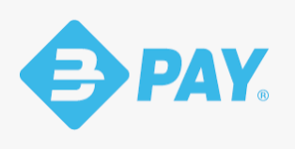
3.1 What are the most popular services?
2021-1-IT02-KA220-ADU-000035139
There are many other services that are popular across Europe. Whether it may be amazon Pay (Digital Wallet) in Cyprus, Girocard (Debit Card) or sofort (Online Banking) in Germany or Bancomat Pay (Debit Card) in Italy. They may have different names. But they all work similarly.
42

Slide 43
3.2 Which payment system is the right one for me?
2021-1-IT02-KA220-ADU-000035139
Short task:
Think about aspects to consider when choosing an e-payment method.
Ask yourself what you want it to be like.
Then compare your findings
Time: 5-10 minutes
43

Slide 44
3.2 Which payment system is the right one for me?
2021-1-IT02-KA220-ADU-000035139
You should consider the following key aspects when choosing an e-payment system:
Acceptance: Choose one that is widely accepted to have flexibility.
Convenience: Choose the payment system that you find is the most accessible to you and that you feel most comfortable using.
Fees & Charges: Compare the fees and charges of different e-payment options to choose the cost-effective one for your needs.
Security: Choose one that is considered secure.
44

Slide 45
Project No: 2021-1-DE02-KA220-VET-000030542
Thank you!
Follow us on Facebook!
Project No: 2021-1-IT02-KA220-ADU-000035139

Slide 46
e-payment
Lesson 4.
How do I know an online shop is trustworthy?
Funded by the European Union. Views and opinions expressed are however those of the author(s) only and do not necessarily reflect those of the European Union or the European Education and Culture Executive Agency (EACEA). Neither the European Union nor EACEA can be held responsible for them.
Developed by Polygonal | Dec, 2022
This project has been funded with the support of the European Commission. This publication reflects the views only of the author and the Commission cannot be held responsible for any use which may be made of the information contained therein.
Project No: 2021-1-IT02-KA220-ADU-000035139

Slide 47
4. How do I know an online-shop is trustworthy?
2021-1-IT02-KA220-ADU-000035139
Discussion
How do you make sure an online-shop is trustworthy?
Have a brief discussion and then compare to information on the following slides.
47

Slide 48
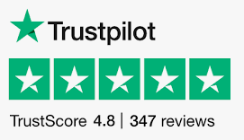
4. How do I know an online-shop is trustworthy?
2021-1-IT02-KA220-ADU-000035139
Check the shops reputation.
One of the best ways to determine whether an online shop is trustworthy is to check what other people say about it. You can do this by reading online reviews and ratings from other customers and by checking the shop's ratings with organisations such as Trustpilot .
48

Slide 49
4. How do I know an online-shop is trustworthy?
2021-1-IT02-KA220-ADU-000035139
Consider the shop's security measures.
Look for signs that the shop uses encryption and other security measures to protect your information, such as a padlock icon in the address bar of your web browser or the use of HTTPS in the shop's web address.
49

Slide 50
4. How do I know an online-shop is trustworthy?
2021-1-IT02-KA220-ADU-000035139
Research the shop's return and refund policies
Before purchasing from an online shop, it is important to research the shop's return and refund policies. A trustworthy online shop will have clear and fair policies to protect your rights as a customer, and will be transparent about these policies before making a purchase.
50

Slide 51
4. How do I know an online-shop is trustworthy?
2021-1-IT02-KA220-ADU-000035139
Look for a privacy policy.
A trustworthy online shop will have a clearly stated privacy policy that explains how they collect, use, and protect your personal and financial information. This policy should be easy to find and understand and give you the information you need to make an informed decision about whether to shop at the online store.
51

Slide 52
Project No: 2021-1-DE02-KA220-VET-000030542
Thank you!
Follow us on Facebook!
Project No: 2021-1-IT02-KA220-ADU-000035139

Slide 53
e-payment
How do I use … ?
Funded by the European Union. Views and opinions expressed are however those of the author(s) only and do not necessarily reflect those of the European Union or the European Education and Culture Executive Agency (EACEA). Neither the European Union nor EACEA can be held responsible for them.
Developed by Polygonal | Dec, 2022
This project has been funded with the support of the European Commission. This publication reflects the views only of the author and the Commission cannot be held responsible for any use which may be made of the information contained therein.
Project No: 2021-1-IT02-KA220-ADU-000035139

Slide 54
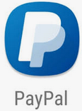
5.1 How do I set up and use a PayPal-Account?
2021-1-IT02-KA220-ADU-000035139
How to set up PayPal on your phone.
iPhone: If you have an iPhone go to the App Store
Not iPhone: If you don't have an iPhone go to the Play Store
Click into the search Tab and enter “PayPal” and press “search”
In the results the PayPal App will show with an Icon that will look like this
Click on the PayPal search result
Click on “install”
Once it is installed, open PayPal by clicking on the app icon
Click on “Sign up” and fill in all the necessary information.
54

Slide 55
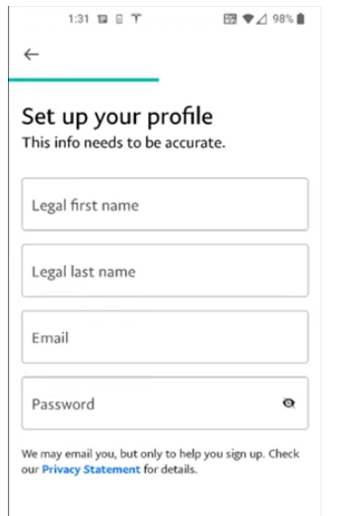
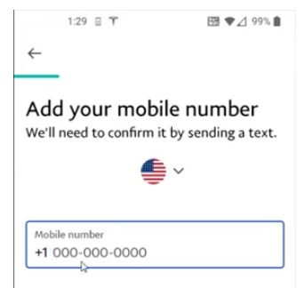
5.1 How do I set up and use a PayPal-Account?
2021-1-IT02-KA220-ADU-000035139
8. Add your phone number and click next:
9. Set up your profile and click next:
55

Slide 56
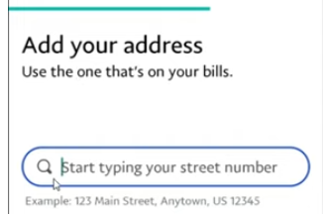
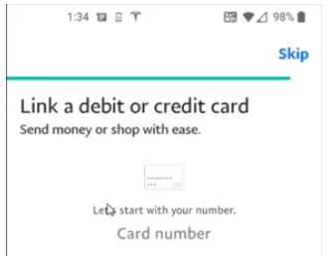
5.1 How do I set up and use a PayPal-Account?
2021-1-IT02-KA220-ADU-000035139
10. Now add your address and then agree and create account:
11. You might be asked to link a debit or credit card - which you can do or skip:
56

Slide 57
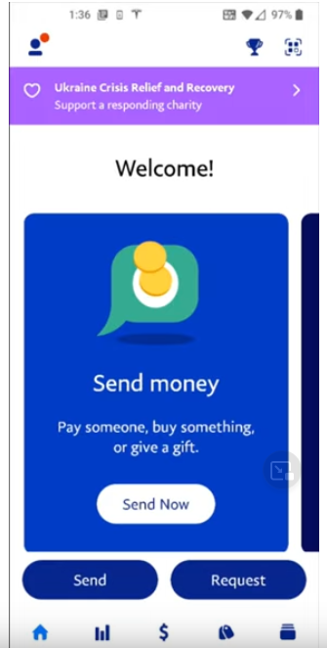
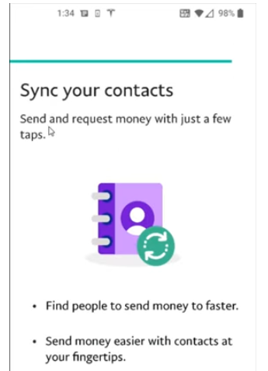
5.1 How do I set up and use a PayPal-Account?
2021-1-IT02-KA220-ADU-000035139
12. You will now be asked to sync your contacts (recommend to skip):
13. Now you will get to the start screen.
To link a bank account or a credit/debit card click on
57

Slide 58
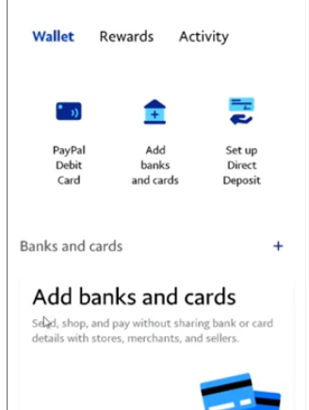
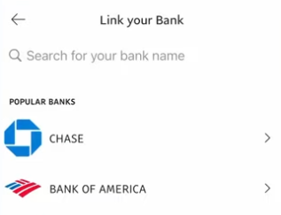
5.1 How do I set up and use a PayPal-Account?
2021-1-IT02-KA220-ADU-000035139
14. Clicking on the icon will lead you here:
15. To link a bank account click “add banks and cards” and then “Banks”.
Then you will get to this screen where you have to enter the name of your bank and select it:
58

Slide 59
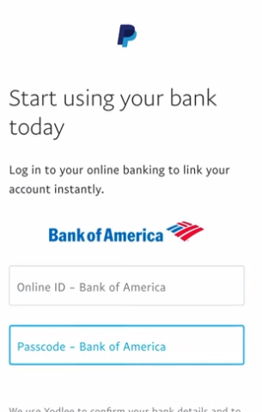
5.1 How do I set up and use a PayPal-Account?
2021-1-IT02-KA220-ADU-000035139
16. You will now be asked to enter the
credentials to your online bank account:
17. The process after this step might vary from bank to bank/country to country. You will most likely be asked to enter a Pin that was sent to your banking app. Once you have entered it PayPal will check with your bank if the code is correct. If that is the case you will get to an overview where you can select the account you want to connect with your PayPal account.
59

Slide 60
5.1 How do I make a purchase using PayPal?
2021-1-IT02-KA220-ADU-000035139
Browse the website and find the item you want to purchase.
Add the item to your shopping cart and proceed to checkout.
On the payment page, select PayPal as your payment method.
You'll be redirected to the PayPal website where you'll be prompted to log in to your PayPal account.
Log in to your PayPal account and review the payment details, such as the amount and shipping address.
Confirm the payment by clicking on the "Pay" button.
Once the payment is processed, you'll be redirected back to the website and receive a confirmation email from PayPal indicating that the payment was successful.
Note: The exact steps may vary slightly depending on the website you're using and your specific PayPal account settings.
60

Slide 61
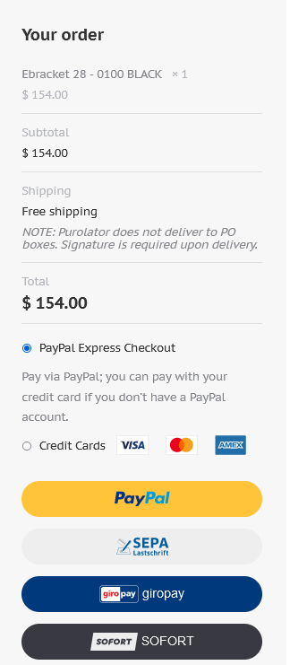
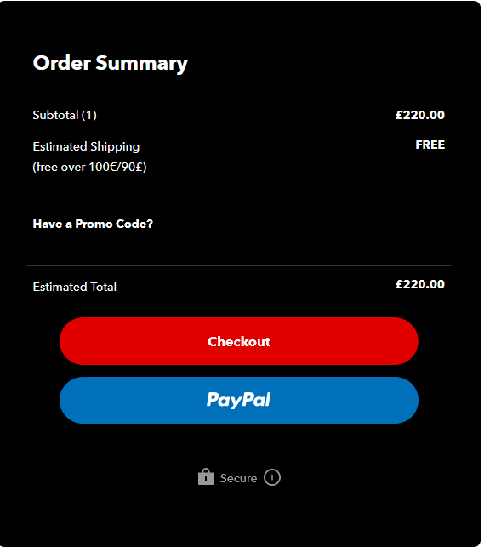
5.1 Examples for purchase with PayPal
2021-1-IT02-KA220-ADU-000035139
Example for what the checkouts with PayPal could look like:
61

Slide 62
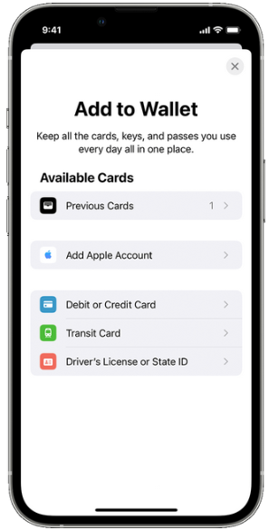
5.1 How do I set up Apple Pay?
2021-1-IT02-KA220-ADU-000035139
Open the Wallet App - the icon looks like this
In the Wallet App tap the button
Tap Debit or Credit Card to add a new card
Tap Continue.
Follow the steps on the screen to add a new card.
Verify your information with your bank or card issuer. They might ask you to provide more information or to download an app before approving your card for use with Apple Pay.
If you have a paired Apple Watch, you have the option to also add the card to your watch.
62

Slide 63
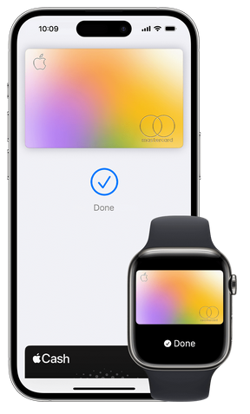
5.1 How do I use NFC using Apple Pay?
2021-1-IT02-KA220-ADU-000035139
Wherever you see these symbols you can pay with Apple Pay.
Pay with your iPhone
To use your default card:
If your iPhone has Face ID, double-click the side button. If prompted, authenticate with Face ID or enter your passcode to open Apple Wallet.
If your iPhone has Touch ID, double-click the Home button.
To use a different card, tap your default card to see your other cards. Tap a new card and authenticate.
Hold the top of your iPhone near the contactless reader until Done and a check mark appears on the display.
63

Slide 64
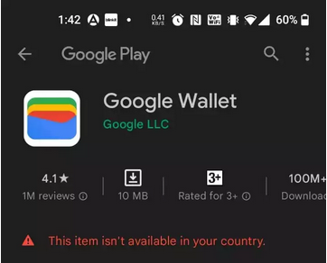
5.1 How do I set up Google Wallet?
2021-1-IT02-KA220-ADU-000035139
Important: The Google Pay app is now the Google Wallet app. If you already have the Google Pay app, you don’t have to download anything new. The next time you open the Google Pay app, it may show as Google Wallet or you’ll be prompted to go to the Play Store and update the app. After the update, the app will appear as Google Wallet.
Before you start: Make sure your android version is up to date otherwise might not work.
Go to the -Store on your phone.
Type “Google Wallet” in the search bar and hit the search button.
Then click on Google Wallet.
Then hit the “install”-button.
64

Slide 65
5.1 How do I set up Google Wallet?
2021-1-IT02-KA220-ADU-000035139
5. Once Google Wallet is installed open it.
6. Follow the setup instructions.
If you’re new to Google Wallet, you’re asked to add a card the first time you open the app. You can use your camera to scan a debit or credit card or enter the details manually.
If you previously added cards, tickets, or passes to your wallet, they should appear in your Google Wallet.
You may be asked to set up a screen lock on your Android device.
7. To make contactless payments, make sure your phone has:
- NFC,
- NFC is turned on
- Google Pay is set as the default payment app -> instructions on next slide
65

Slide 66
5.1 Set or change your default payment method
2021-1-IT02-KA220-ADU-000035139
Find your default payment method
Open the Google Wallet app
At the top, on your payment methods, swipe from the right edge of the screen to left until you get to the last one.
Tap Edit card order .
Your default method has a contactless symbol .
Change your default payment method
Open the Google Wallet app .
At the top, on your card, swipe from the right edge of the screen until you find the card that you want to use as your default.
Tap the card.
At the bottom, tap Details > Make default for tap to pay.
66

Slide 67
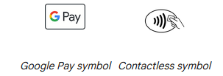
5.1 How do I pay in a store using Google Wallet?
2021-1-IT02-KA220-ADU-000035139
Wherever you see these symbols you can pay with Google Wallet.
Step 1: Wake up & unlock your phone
Turn on your screen, then unlock your phone. You don’t need to open the Google Wallet app.
Tip: In most countries or regions, smaller transactions don't require you to unlock your phone.
Step 2: Hold the back of your phone close to the payment reader for a few seconds
When you’re done paying, a blue check mark appears on the screen.
67

Slide 68
5.1 How do I pay in a store using Google Wallet?
2021-1-IT02-KA220-ADU-000035139
Troubleshooting:
If the check mark isn’t on your screen:
Try to hold your phone in a different way. Your NFC antenna could be near the top or bottom of your device.
Hold your phone closer to the payment reader.
Hold your phone to the payment reader for a few extra seconds.
If there’s a check mark but the cashier says that the payment didn’t work:
Double check that the store accepts mobile payments.
Contact your bank. There may be an issue with your card and your bank may have declined the transaction. If the transaction is declined, you aren’t charged.
68

Slide 69
5.1 How do I pay in a store using Google Wallet?
2021-1-IT02-KA220-ADU-000035139
Wherever you see these symbols you can pay with Google Wallet.
Step 3: If prompted, follow the on-screen instructions
Some stores ask for a PIN or signature. If you’re asked, follow the steps on the screen.
Debit cards: Enter the PIN that you set up with your bank. This PIN is different from the one you use to unlock your device.
Credit cards: For larger transactions, sign the receipt or the on-screen signature box.
69

Slide 70
5.1 How do I set up Online Banking?
2021-1-IT02-KA220-ADU-000035139
Example Login-Screen:
70

Slide 71
5.1 How do I set up Online Banking?
2021-1-IT02-KA220-ADU-000035139
Locate the online banking section on your bank's website or visit your local branch to discuss the options for setting up online banking.
Follow the instructions to enroll in online banking, typically by providing personal information, such as your name, address, and account number.
Sometimes you have to set up a username and password yourself.
Confirm your enrollment by following any additional instructions provided by the bank, such as confirming your email address or answering security questions.
71

Slide 72
5.1 How do I set up Online Banking?
2021-1-IT02-KA220-ADU-000035139
Log in to your online banking account and verify that all of your account information is correct. You can either login via a browser like Google Chrome or download the app of your bank from the app store if you have an iPhone or from the Play Store if you don't have an iPhone.
Familiarise yourself with the features of your online banking account, such as viewing account balances, transactions, and bills, and making transfers and payments.
Set up any additional security measures offered by the bank, such as two-factor authentication, to protect your account.
72

Slide 73
5.1 How do I transfer money using Online Banking?
2021-1-IT02-KA220-ADU-000035139
Log in to your online banking account.
Once you're logged in, look for "Pay Bills" or "Payments" section. This is where you can initiate a payment.
Choose the option to "Add Recipient" or "Add Biller". Here, you'll need to provide the name of the person or company you're paying, their account number or billing code, and any other required information. This is typically a one-time process, and you won't need to do it again for future payments to this payee because the bank will safe this information.
Enter the amount you want to pay, and choose the account from which the funds will be drawn.
Select the date you want the payment to be made. Some banks may offer the option to schedule recurring payments.
73

Slide 74
5.1 How do I transfer money using Online Banking?
2021-1-IT02-KA220-ADU-000035139
Review the payment details to make sure everything is correct, and then click "Submit" or "Confirm".
You may be asked to provide additional authentication, such as a one-time password or confirmation via a mobile app, to verify the transaction.
Once the payment has been initiated, you should receive a confirmation message or receipt.
That's it! Online banking makes paying invoices quick and convenient, and you can do it from the comfort of your own home or office. Just remember to double-check all the details before submitting the payment to avoid any errors or delays.
74

Slide 75
Project No: 2021-1-DE02-KA220-VET-000030542
Thank you!
Follow us on Facebook!
Project No: 2021-1-IT02-KA220-ADU-000035139
This project has been funded with the support of the European Commission. This publication reflects the views only of the author and the Commission cannot be held responsible for any use which may be made of the information contained therein.

